Slide 1

Welcome To
Hanley St Luke’s C of E Aided Academy
Online Safety Parent Workshop
(EYFS & KS1)

Slide 2
The idea of today’s session…
Not to put children off being online.
Technology is changing and we need to prepare our children for this world (AI, more jobs using the internet, by 2030 there will be jobs in technology that we don’t even know about today)
We need to be aware of the risks and know how to support our children.
Online safety is taught in schools and is part of the National Curriculum.

Slide 3
How do you keep your children safe online?

Slide 4
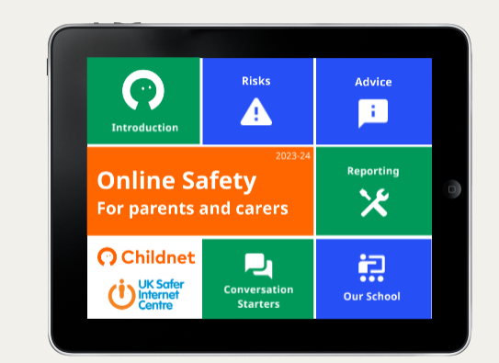

Slide 5
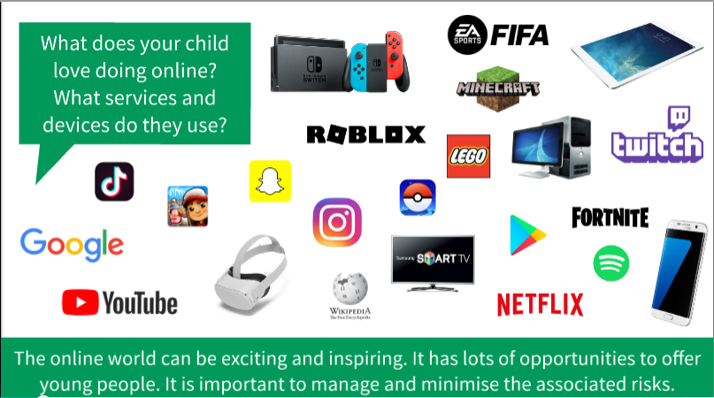

Slide 6


Parenting in a digital world
Online Safety for Parents of Children aged 3-7 | National Online Safety (nationalcollege.com)

Slide 7


What are children accessing online?
Online Safety for Parents of Children aged 3-7 | National Online Safety (nationalcollege.com)

Slide 8
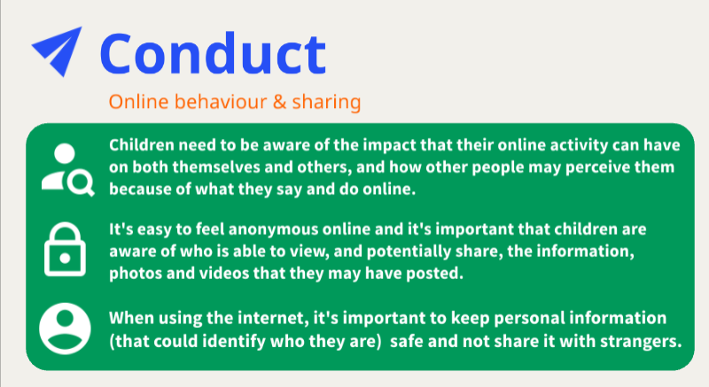

Slide 9
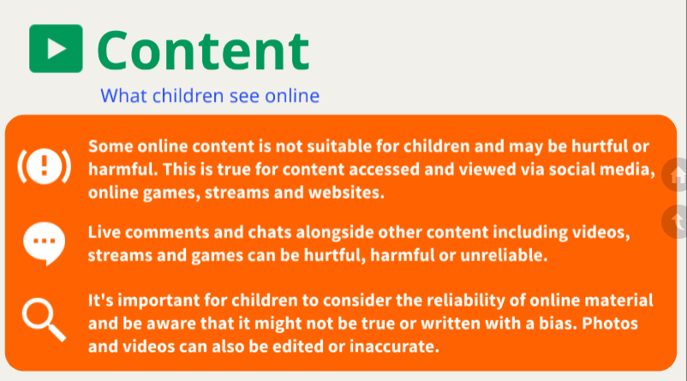

Slide 10
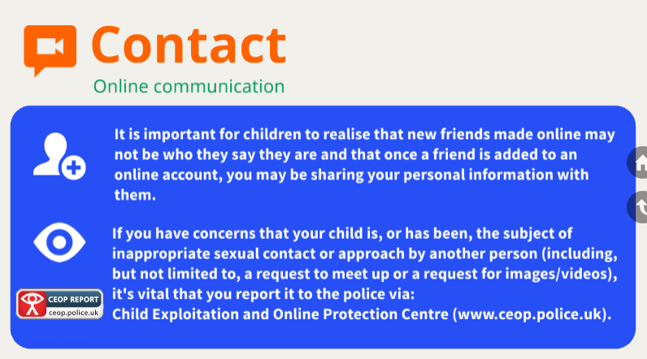

Slide 11
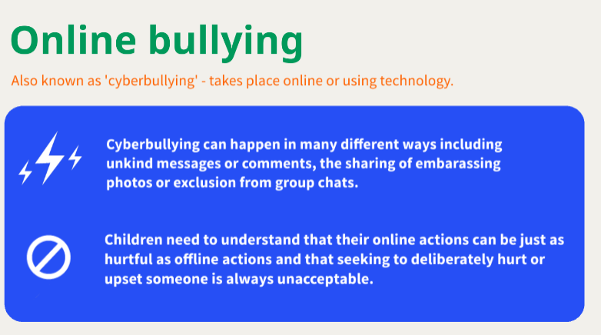

Slide 12
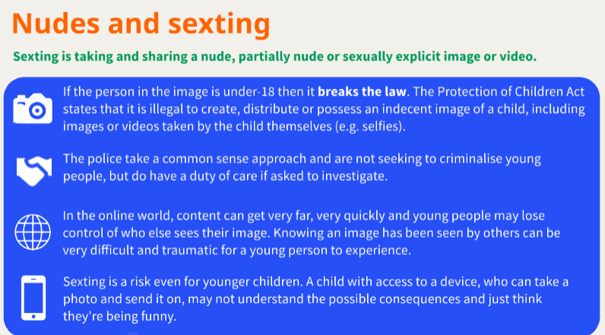

Slide 13
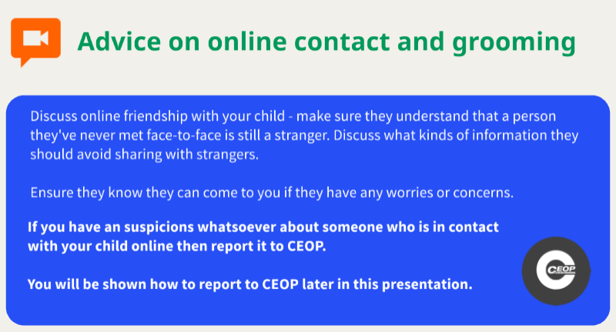

Slide 14
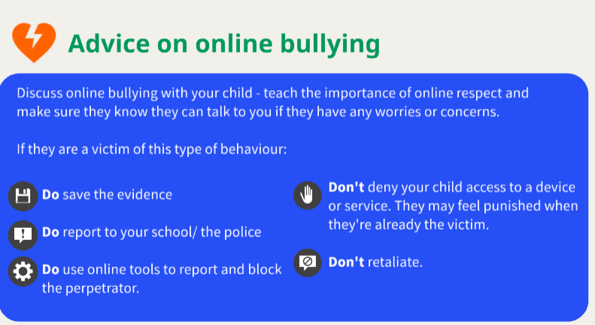

Slide 15
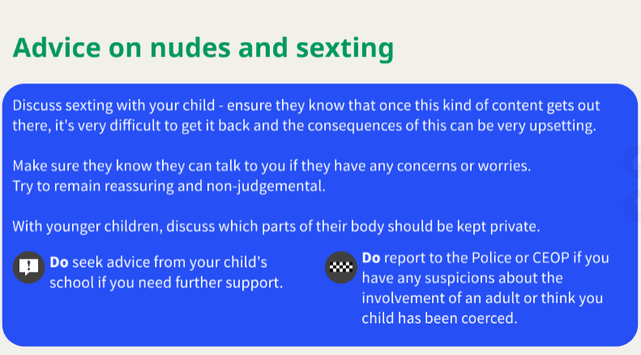

Slide 16
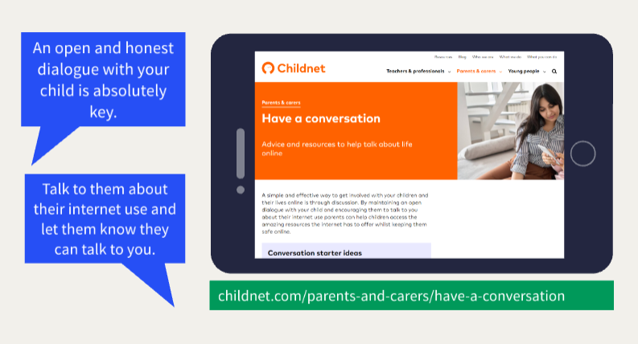

Slide 17
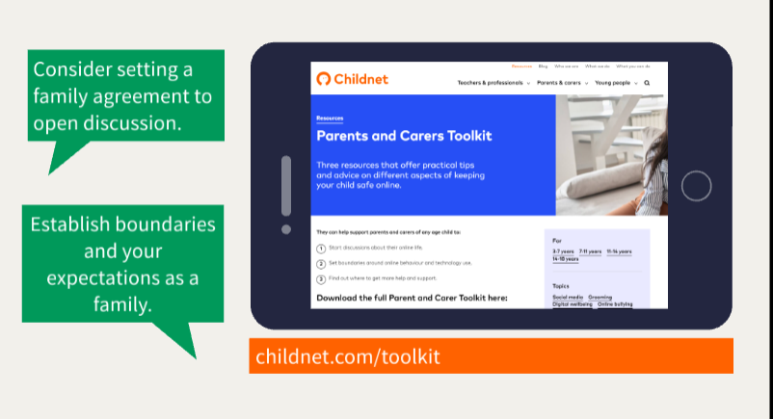

Slide 18
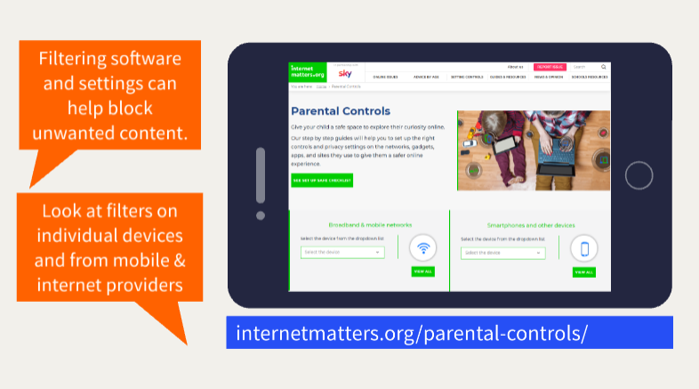

Slide 19
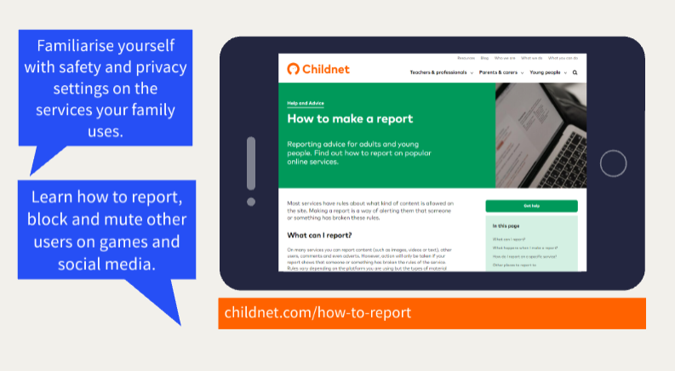

Slide 20
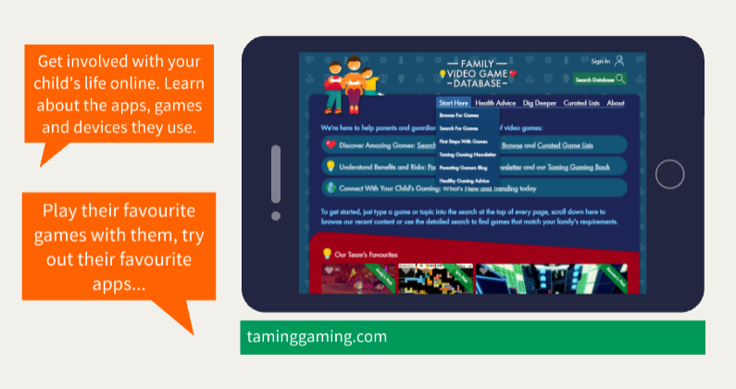

Slide 21
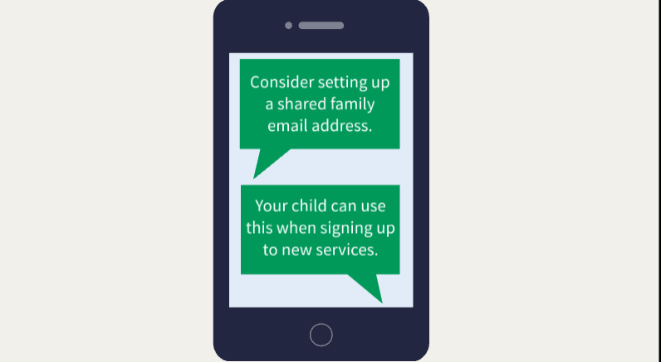
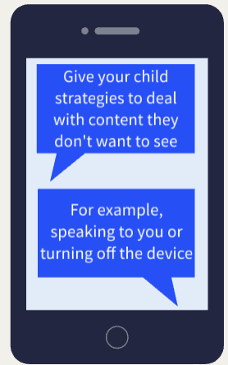

Reflection
Online Safety for Parents of Children aged 3-7 | National Online Safety (nationalcollege.com)

Slide 22
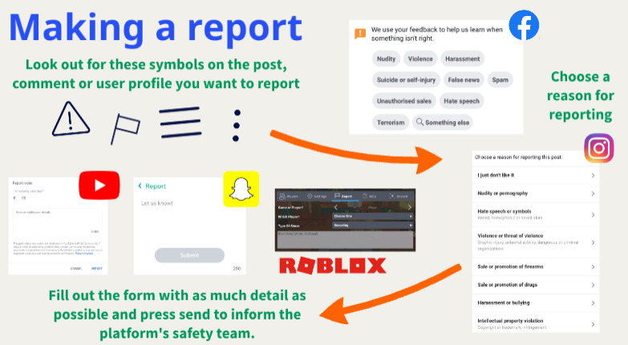

Slide 23
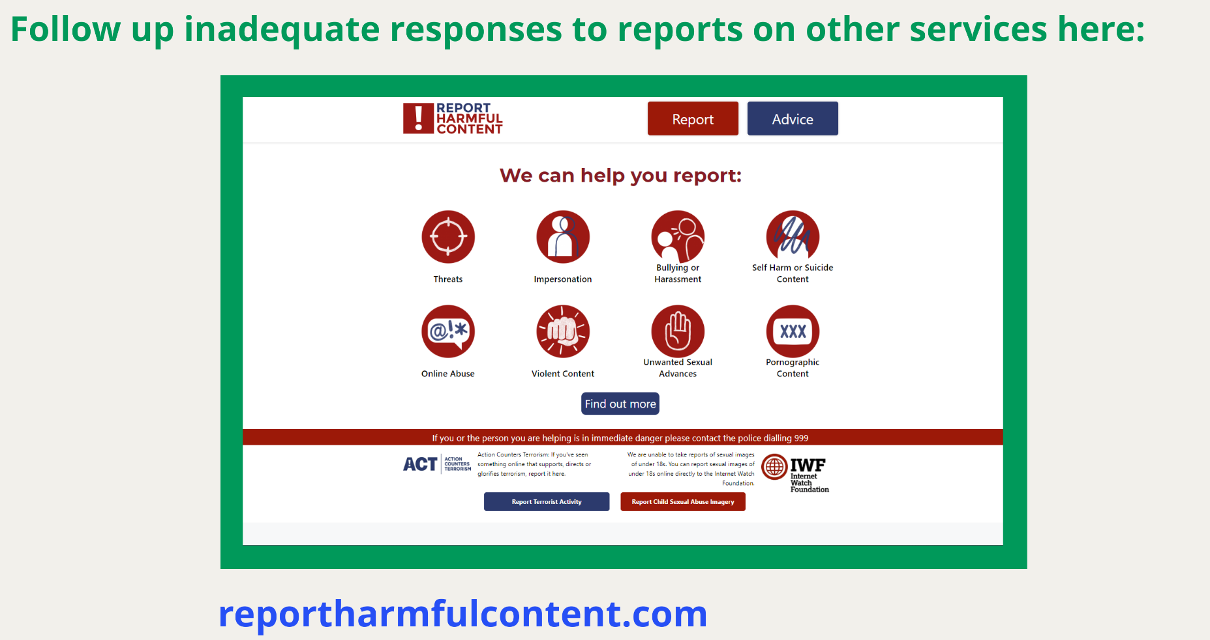

Slide 24
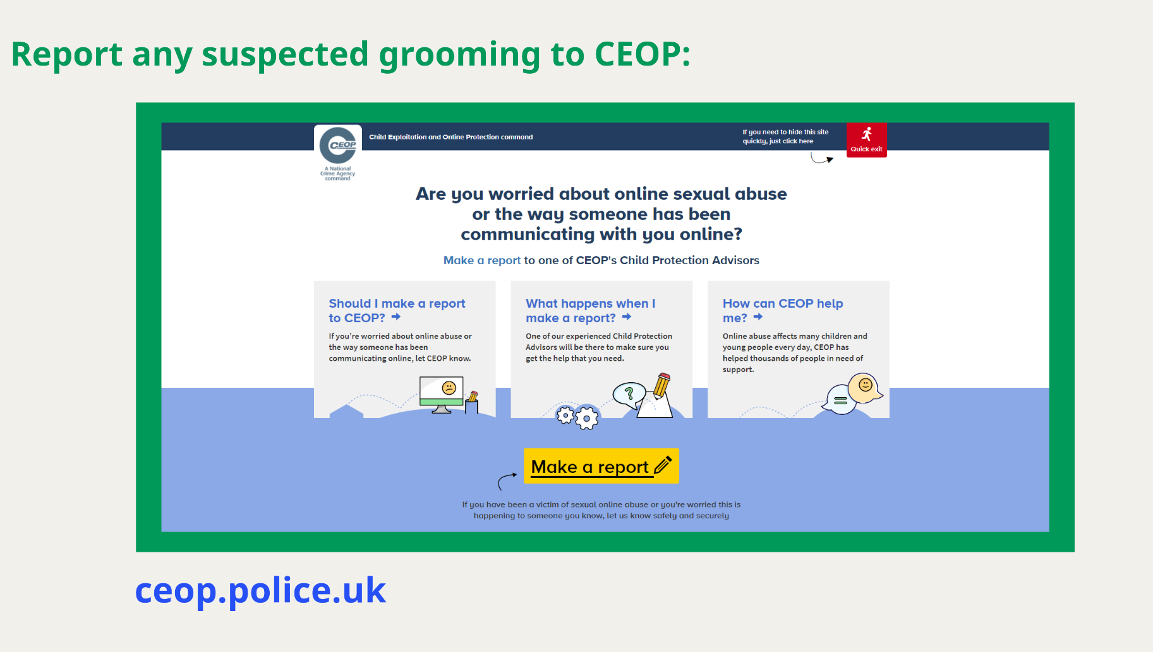

Slide 25
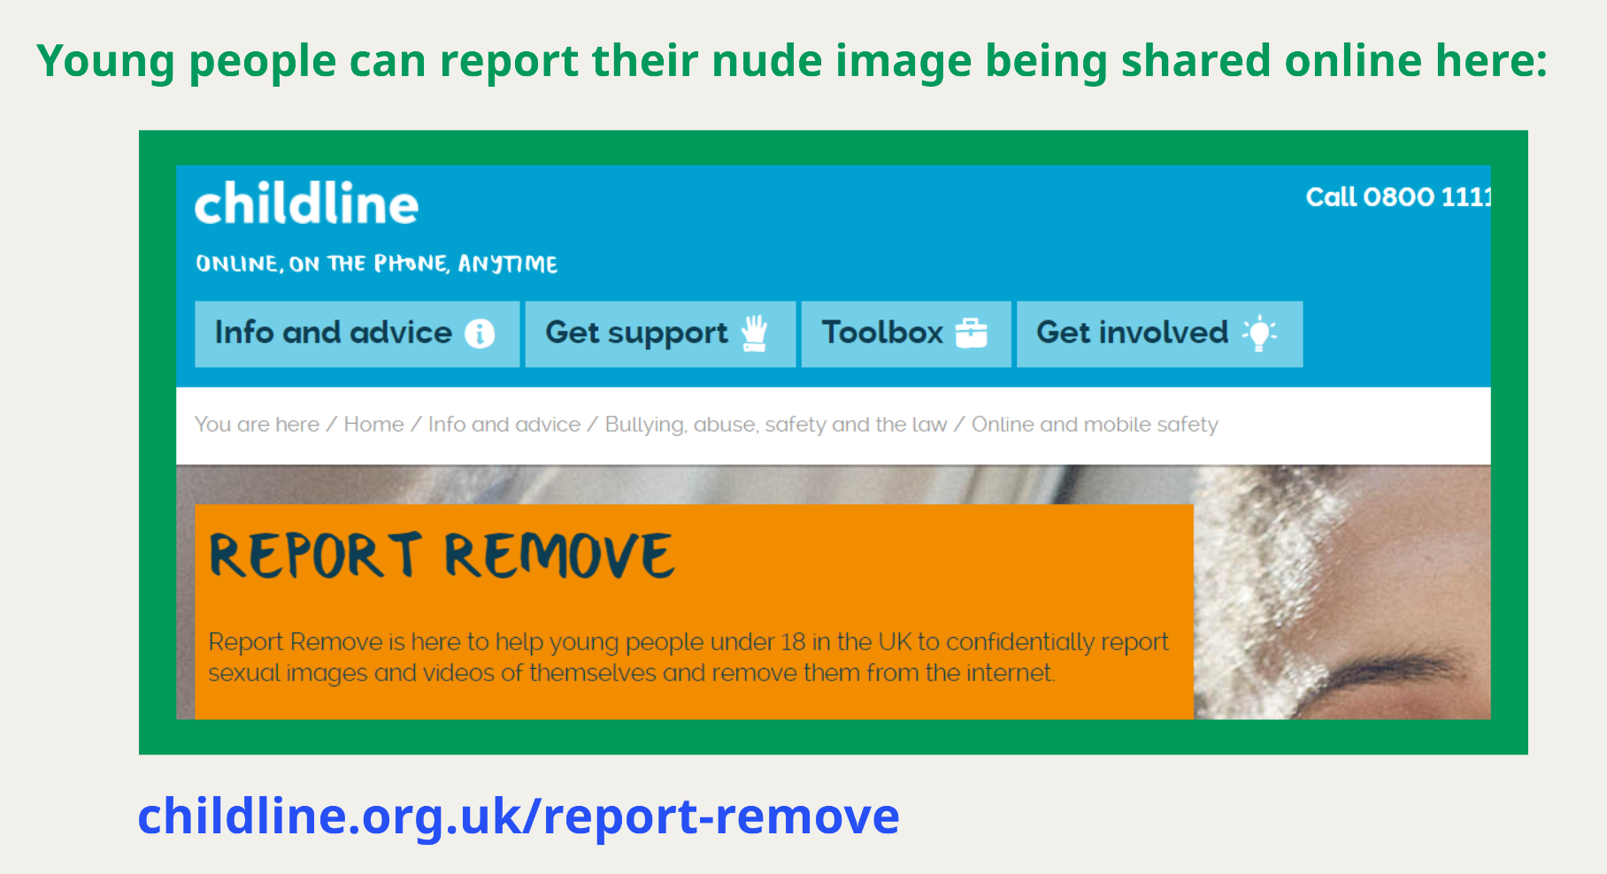

Slide 26
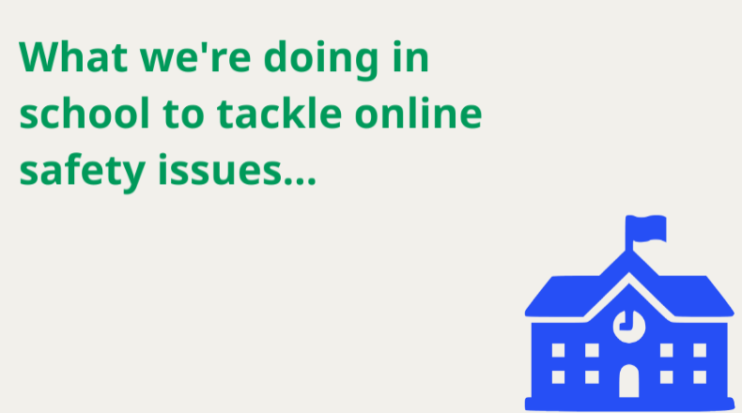

Slide 27
How we tackle online safety at HSL
Appropriate filters and monitoring within school.
We teach online safety as part of our curriculum and celebrate Online Safety Day. Where children have designed posters to encourage others to stay safe online.
Through our school policies – Safeguarding, Online Safety policy, Acceptable Use policy.
Home/School agreements and school rules e.g restricted use of mobile phones in school.

