Slide 1


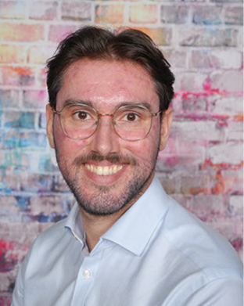
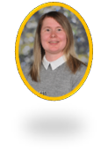
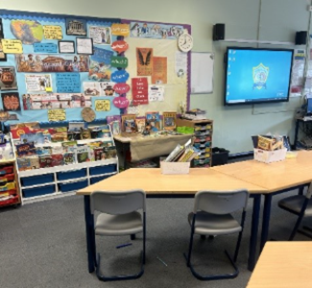


Hello and Welcome to 6S
Meet your new teacher and support staff.
We can’t wait to welcome you!
Mr Rogers
Mrs Adams
WELCOME TO 6S!
We’re looking forward to sharing our class texts of Holes, Skellig and Once with you this year. In Geography we’ll be learning lots about Rivers, Biomes and developing our Mapping Skills – lots of this work will happen during our residential to Stanley Head in October. Our History topics include Ancient Greece and The Battle of Britain as well as learning about canals and the work of James Brindley on our local history day. In Science we’ll learn more about classification, how our bodies work and Electricity. There’s more, lots more! We can’t wait to get going!
Our new classroom
Mr Rogers loves sport and keeping fit – you may even spot me running around Hanley or by the canal.
In Year 6, we enjoy several trips including Stanley Head, to enhance our Geography, local visits to the canal, the library and the Potteries Museum for Operation Spitfire.
It’s certainly a busy final year and one that tends to fly!
Please reach out to me if you have any questions about your child.
“Education is one thing that no one can take away from you.”
For more information click here to see our year group page on our school website.

Slide 2





Key Information
Your child has been given a login for Numbots (Reception–Y1) and Times Tables Rock Stars (TTRS) (Y2–Y6), which help children learn key number facts and times tables that are essential for confidence and progress in maths—please encourage your child to practise regularly at home using their login at https://play.numbots.com and https://ttrockstars.com.
READING AT HOME EXPECTATIONS
Regular reading at home plays a vital role in children’s learning and development across EYFS, KS1 and KS2. We encourage children to read at least 5 times a week, as this helps to build confidence, improve language and comprehension skills, and foster a love of books. Reading little and often supports progress in all areas of the curriculum, not just English. To celebrate this, we offer reading rewards to recognise effort and commitment, helping to motivate children and make reading a positive, enjoyable routine at home.
Key Dates, Trips &
Events Information
  Reading Challenge (Summer term)
  Wed 9th Sep Meet the Teacher drop-in 3:30-4:30pm
  Mon 14th Sep Stanley Head meeting 3:30-4pm
  Tues 6th Oct Past Pupils' High School Tips 4-5pm Mon 12th-Fri 16th Oct Stanley Head Residential
  Tues 4th/10th November: Library Visit
  Wed 11th Nov School Photos
  Mon 16th Nov: Flu Jabs
  Mon 1st March 9-10:30am Mothers’ Day Breakfast.
  Mon 19th April 3:30-4pm Parents’ SATs Meeting
  Mon 10th – Thurs 13th May SATs COMPULSORY
  Mon 17th May Leavers’ Photos
  Tues 13th June 9-10:30am Fathers’ Day Breakfast
  Thurs 15th July 6-8pm Year 6 Prom
  Friday 16th July 9am Leavers’ Assembly and Awards
Our School Vision:
“I have come that they may have life and have it to the full.”
(John 10:10)
“Education is one thing that no one can take away from you.”
For more information click here to see our parent page on our school website.

