Slide 1


Be Ready, Be Responsible, Be Safe

Slide 2
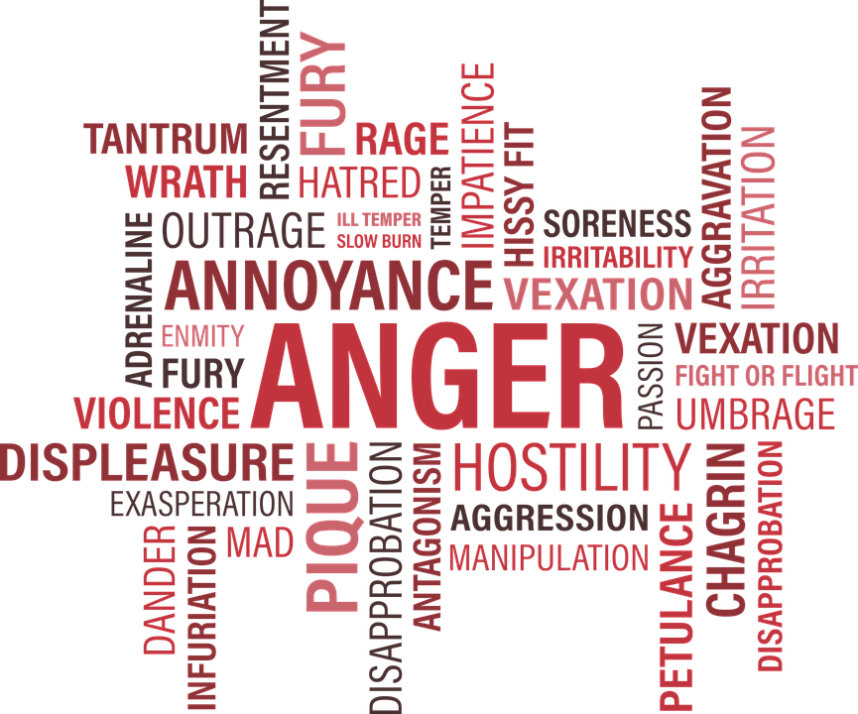
Sometimes we feel…..

Slide 3
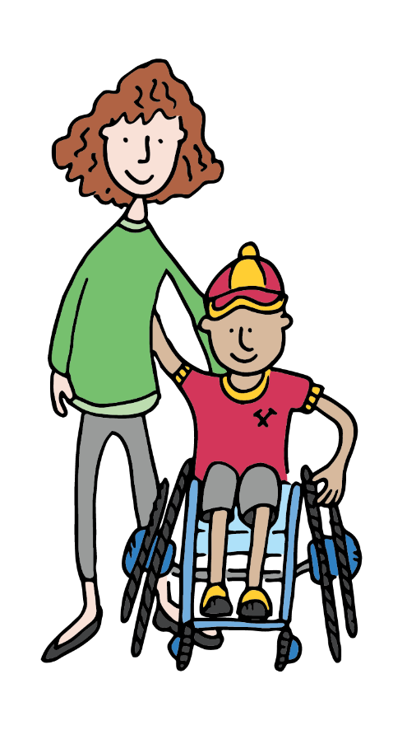

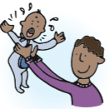
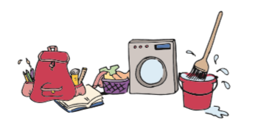
What is a carer?
Notes:
So, what is a carer?
A carer is someone who looks after someone else… normally that is your mum, dad, foster carer or guardian. Everyone here has one.
A carer is someone who look
For example they’ll cook your favourite meals or do the shopping and the house work.
I’m sure many of you help out at home: cleaning your room, cooking, shopping
Hands up? Who helps at home? Well done, thank-you, hands down
That’s good, it’s normal to help out and you are learning good things for your future so you can become independent and look after your selves when you are grown up.
But in some families, there may be someone who has been ill for a long time or has (what we call) a disability

Slide 4
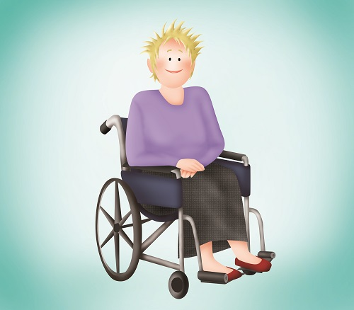
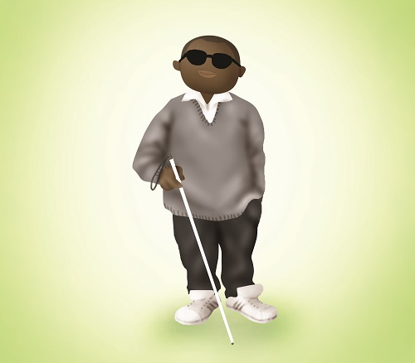
What is a disability?
Notes:
A disability is when part of body or brain, doesn’t work as it should e.g. problem with eyesight / hearing / legs – in wheel chair. OR something you can’t see on the outside but inside the body or head.
So in these families, where someone has disability or has been ill for long time and needs extra help, the children often have to do more at home, and we call them young carers.

Slide 5
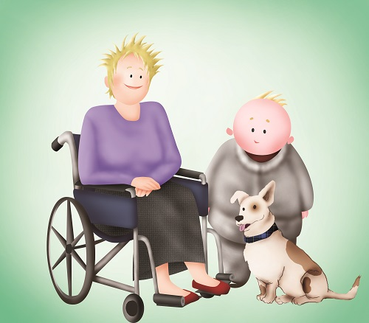
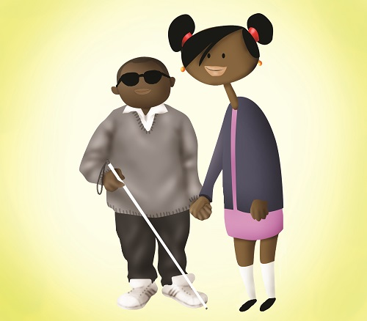
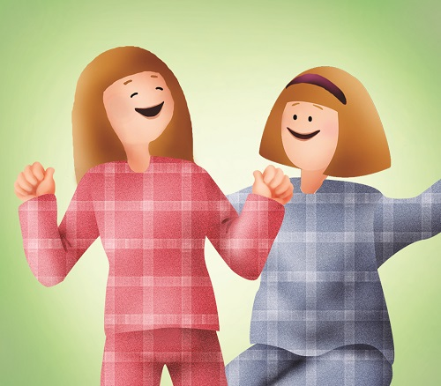
What is a young carer?
Notes:
So we often find YC do a lot more than we would expect someone of your age to do.

Slide 6
So a young carer might help with:
Cooking
Cleaning
Shopping
Talking
Listening
And they may worry…
Notes:
So a young carer might help with:
Cooking/ cleaning / shopping
Fetching things for someone/ giving them their tablets and medication
Listening and talking to someone who’s ill
Looking after their brothers and sisters while mum / dad looks after mum/dad
Or maybe even helping a parent get washed and dressed
We are now going to watch a film about three YC who are all helping look after someone
I’m going to ask you some questions afterwards so watch and listen carefully. Play film DIFFERENT BUT NORMAL

Slide 7
Video:
Different but normal https://www.youtube.com/watch?v=mkxC8Qbww8U&t=12s
Notes:
Watch video

Slide 8
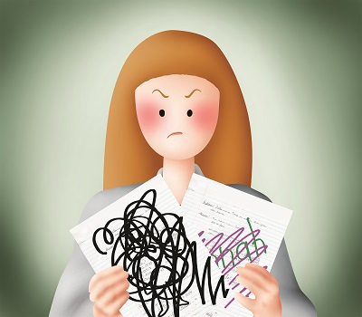
Notes:
So who was our first YC in the film? (Ask the same questions for each character & get them to put their hands up)
1) Louise and who did Louise look after? that’s right, her sister Hannah. Hannah had what we call Autism - that’s when someone’s brain works differently from other peoples – so they may have trouble understanding what people are feeling, and trouble talking to people.
How did Louise care for sister? Hands up............ yes, by playing / drawing with her. But sometimes Hannah drew on Louise’s homework - which did not go down well at school. We also saw pictures of Hannah jumping up and down on the bed, keeping Louise awake at night, so she was tired in school the next day.

Slide 9
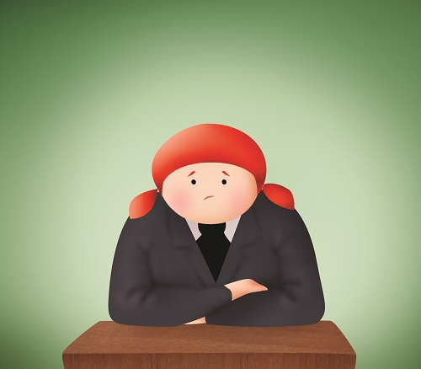
Notes:
2) Libby – who did she look after? Her mum, who had a mental health problem, she had something like bipolar disorder, sometimes she was very happy and sometimes very sad – her moods went up and down like the roller coaster. This would make Libby very sad, and she felt helpless. When mum was having a bad day, she would have to get herself ready for school. She used to worry in lessons and didn’t feel like joining in at playtime, and sometimes she got picked on by the other children.

Slide 10
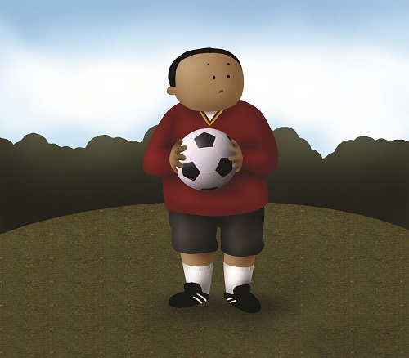
Notes:
3) Billy - who did he look after? his dad – his Dad drank too much, he drank so much alcohol that he used to forget to do things, like going to Billy’s football match. And we saw pictures of Billy doing the washing up, the ironing, mopping the floor, and doing the painting and decorating.

Slide 11





Worry
Notes:
All these YCs had something in common, and that was that they used to worry about the person that they were looking after.
Everyone worries, it’s normal to worry; you might be worrying about your football team – are they going to win, or your pocket money – have you got enough to buy what you want? These are all very normal worries.
But sometimes we worry about bigger things, and if we don’t do anything about these worries they start to get bigger and affect other parts of our lives, and make us unhappy.
So how can we make our worries smaller? Tell someone about your worries, someone you trust: talking to someone you trust can really help. In the film, all the YCs had someone that they could talk to Louise→ teacher Libby→ friend Sophie Billy → Gran and that helped them.

Slide 12
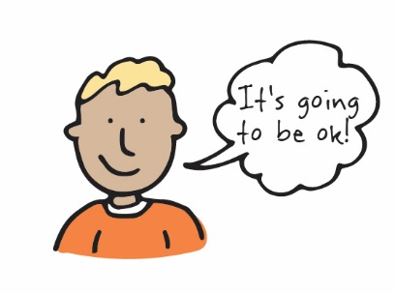
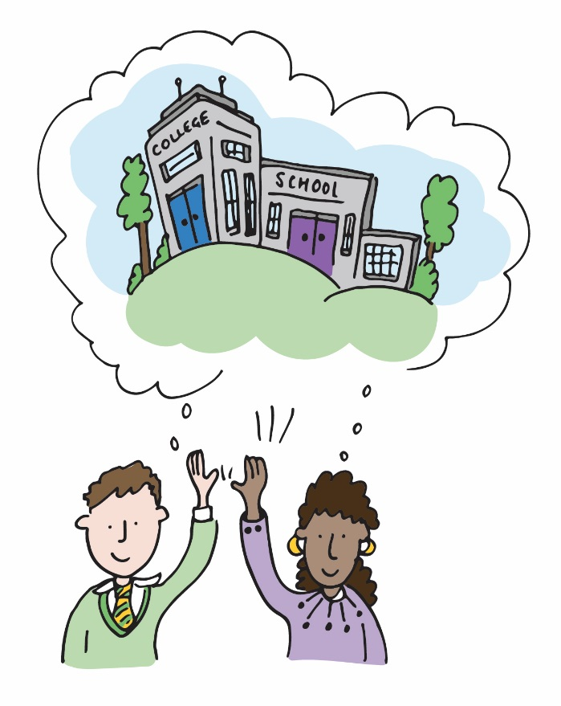
Who can you talk to?
Family
Teachers
Adults at school
People we trust
Friends
Notes:
Who is a good person to talk to? Hands up
Whoever looks after you at home; mum, dad, foster carer, relatives, grandparents, brother, sister, good friends, teachers and other adults at school. All good people but the most important thing is that it is SOMEONE YOU TRUST

Slide 13
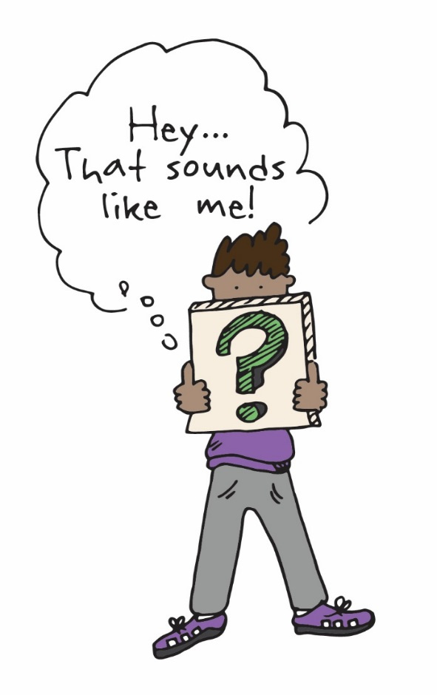

If you think you are a young carer, who can help?
School
Speak to your teacher if you are worried about anybody at home
Young Carers
Someone to talk to
Help for young carers and their families
Fun days out
Notes:
Now maybe after watching the film you think that you might be a YC.
Maybe you help out at home, help look after your brothers or sisters, or even helping to look after a parent/ guardian.
Or spend a lot of time listening to someone
Perhaps this makes you tired, or sad, or you worry a lot.
It may help to talk to someone about this.
If you think that you are a YC , then talk to someone in the school about it. Talk to one of your teachers.
I work for SYC –We can come into school and talk to young carers
And what does Surrey Young Carers do?
We run activities and fun events so that YC’s can have a bit of time off just for them.
We can come into school to help you or to speak to your teachers about how things are at home.
And we can tell your family lots of other places to get different kinds of help too.
So remember if you are worried about something, talk to someone you trust - don’t keep your worries to yourself

Slide 14
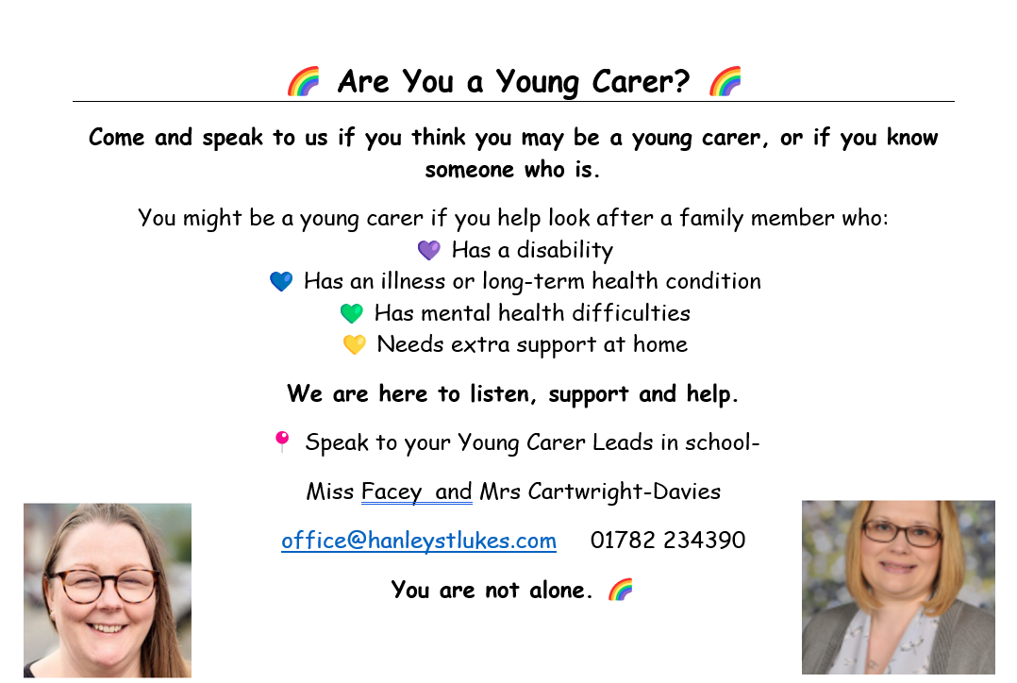

Slide 15
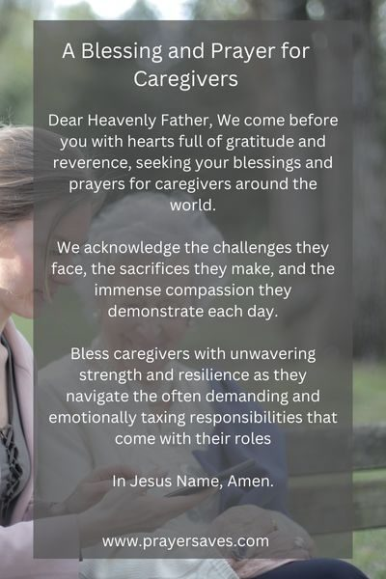

Let us pray

Slide 16


Class Task
Discussion point
Have you ever considered yourself a Young Carer?
What is the difference between helping out and being a carer?
What are caring jobs? Can you name them? What do they do?
Be Ready, Be Responsible, Be Safe

