Slide 1

Focus on
Welcome to
Hanley St Luke’s:
Times Tables- Parents Meeting April 2026

Slide 2
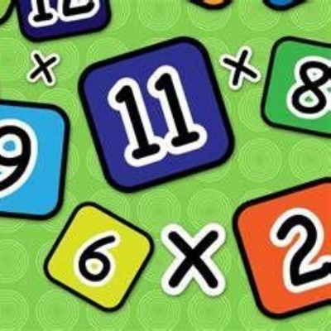
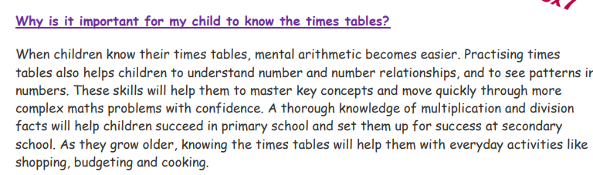

Slide 3
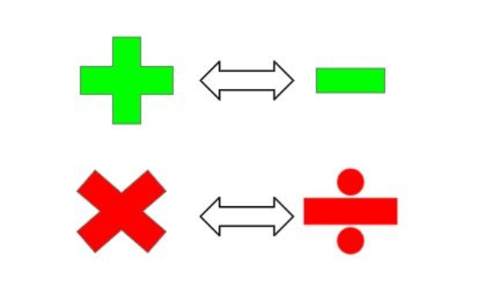
5 x 6 = 30 30 divided by 6 is 5

Slide 4
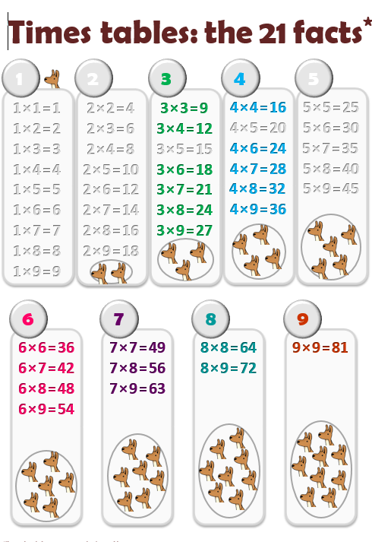
We focus on these 21 facts- children tend to know 1,2, 5 and 10 x tables and their reverse.
These are the x tables left/ not covered by those.

Slide 5
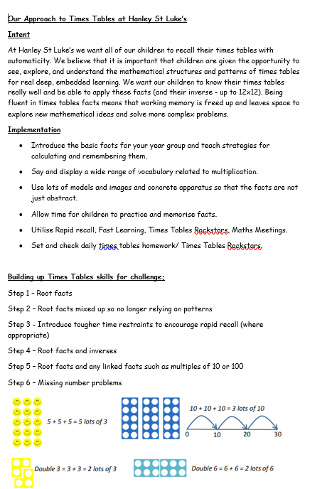
Policy
We don’t' just start learning times tables in Year 4.
Number sense and fluency starts right at the beginning in Nursery and carries on into year 6 and beyond.

Slide 6
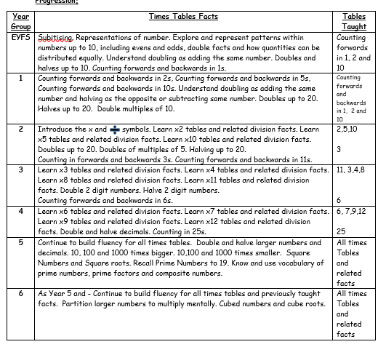


Slide 7
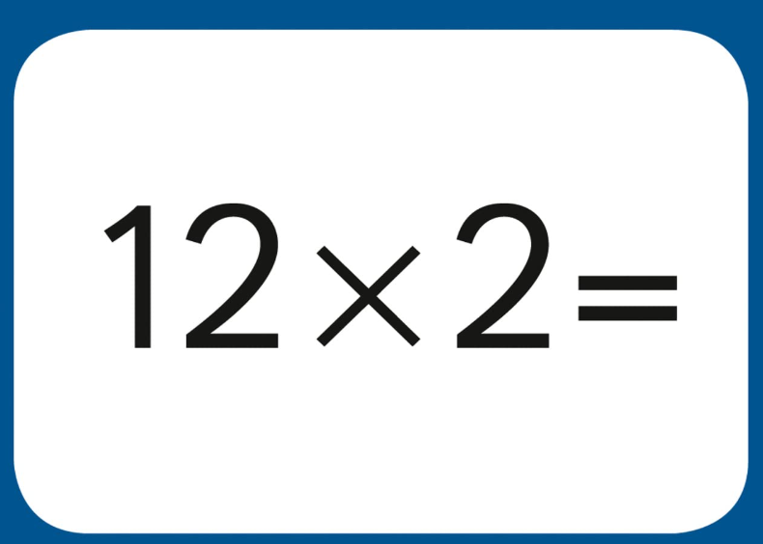

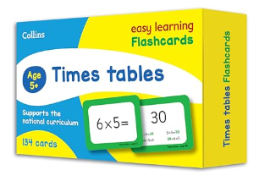
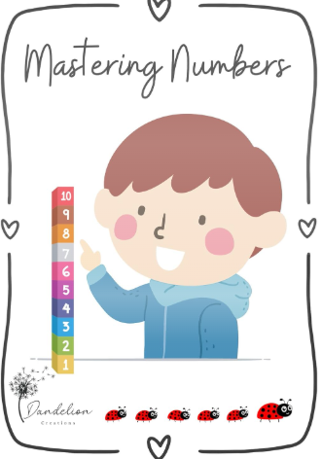


Daily/ weekly practice in school

Slide 8
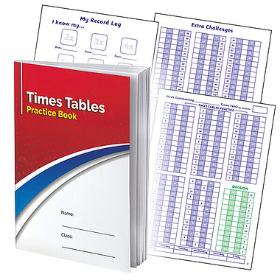
Daily/ weekly practice at home

Slide 9


The Multiplication Tables Check
(MTC)

Slide 10
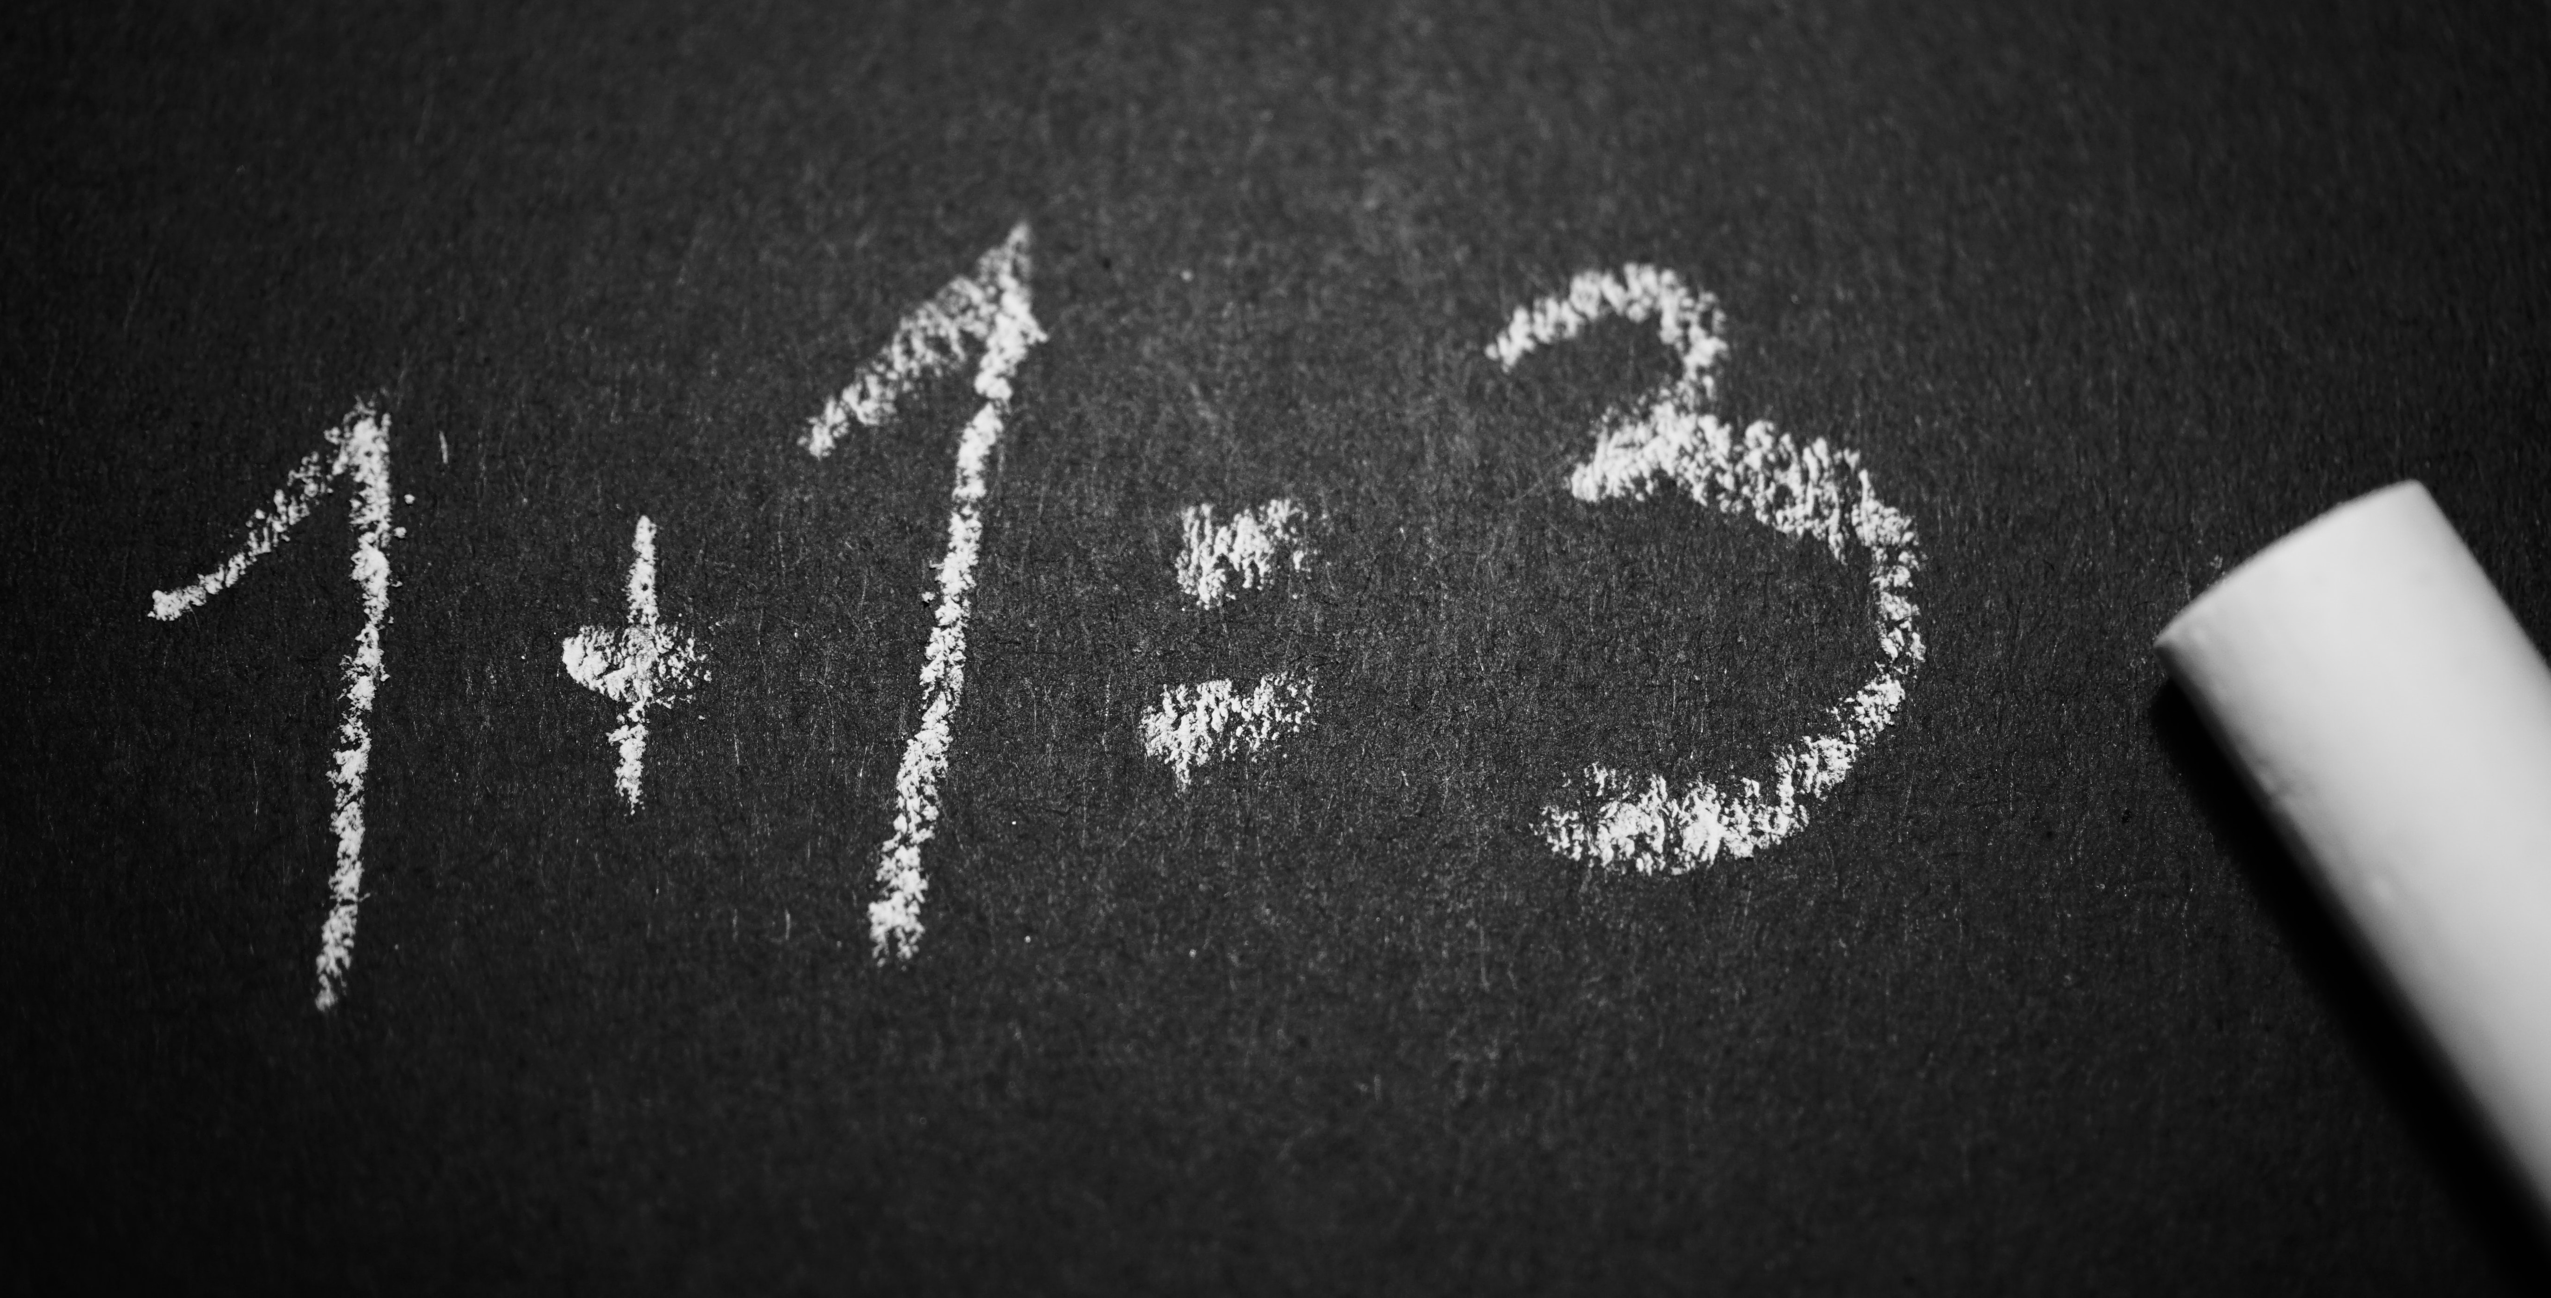


What is The MTC?
It’s a national test for Year 4 students taken online.
Under the national curriculum primary school children are expected to know all their 12 times tables by the end of Year 4
We’ve been preparing students to know their times tables by the end of Year 4 for quite some time.
This will take place after half term in June.

Slide 11

The practicalities
The Check Itself.
Takes place in June
Is done on a tablet or computer
Will take no longer than 5 minutes
There are 25 questions
Pupils have 6 seconds to answer each question- need to take their time and not press enter
There’s no problem solving or division just simple “3 x 4 = ?” type questions
The results are for Teachers
There is no pass or fail mark
Results are not published but we will share with you and the children

Slide 12
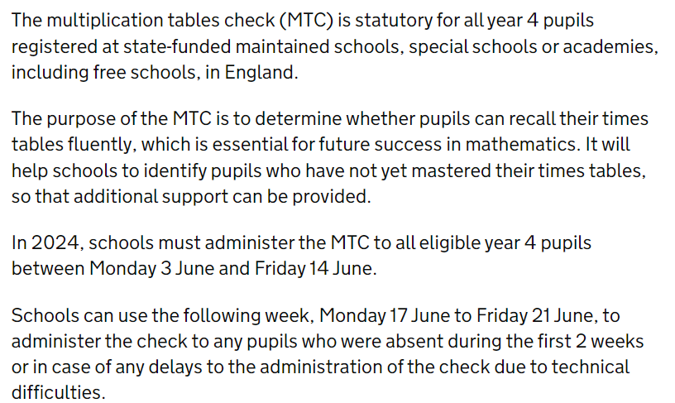
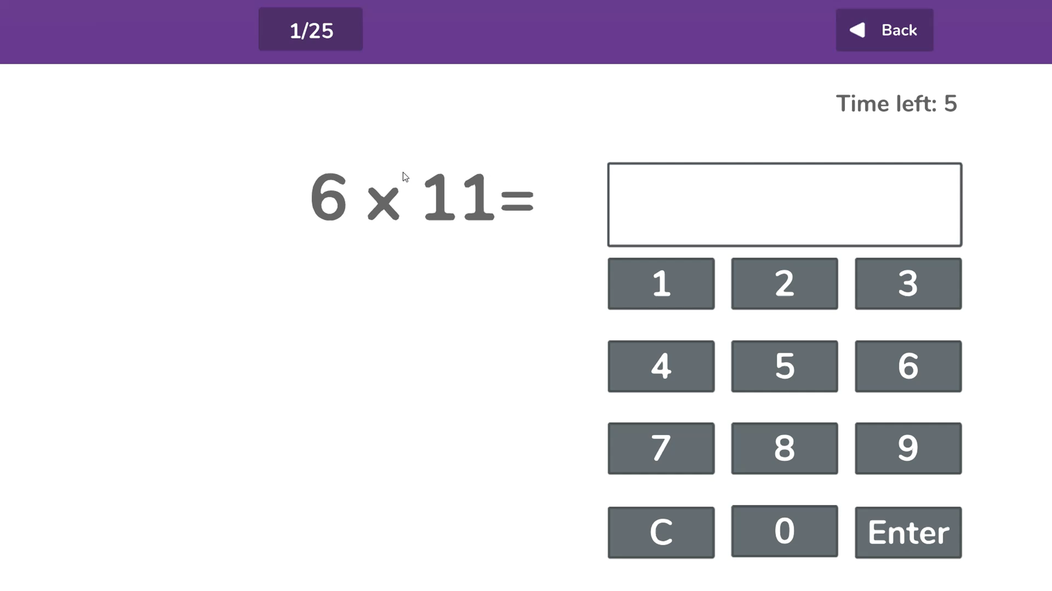
The screen will look similar to this.
Children are used to this- they have been using a simulator regularly.
We will have a mock mtc week so they can get used to the groups and location too

Slide 13

How You Can Help YouR Child?
Practise at Home
We will of course continue to teach the full curriculum, and would love your continued support to help practise the times tables with your children.
Some easy ways to do this include:
asking questions such as “What’s 7 x 8?”
Completing red times tables books regularly.
Reciting times tables by Rote (4 times 1 is 4, 4 times 2 is 8, etc)
singing times tables songs (there are lots online)
Using apps and games (like TTRS)
Games and activities like we’ll play today
Mock MTC’s using MathsFrame

Slide 14

Make times tables fun;
• Climb stairs counting in multiples
• Play verbal times tables games and have competitions
• Take it in turns to say different times tables in funny voices (i.e.say 2 x 3 = 6 in a lion’s voice)

Slide 15

https://www.gov.uk/government/publications/multiplication-tables-check-information-for-parents MTC Guidance For Parents
https://ttrockstars.com/ Times Tables Rockstars
https://mathsframe.co.uk/en/resources/resource/477/Multiplication-Tables-Check Practise MTC Tests
https://kangaroomaths.co.uk/wp-content/uploads/filebase/Calculation/calculation/21_table_facts.pdf 21 Facts to focus on

Slide 16

Thank
You
for your continued support

Slide 17

We are going to play some times tables games and take part in some practice now- there are grids to help you.
Over to you- staff and maths ambassadors are on hand to help you!

Slide 18
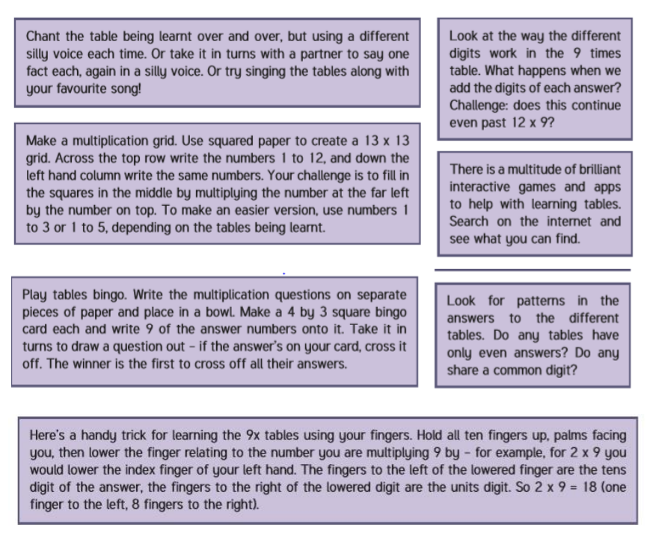
-TTRS
-FAST LEARNING
-TTRS GRIDS- SPEED CHALLENGE
-COUNTERS AND EQUIPMENT- MAKE THE NUMBER TO MATCH THE CARDS
-sNAP

Slide 19


