Slide 1


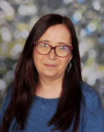
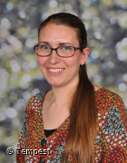
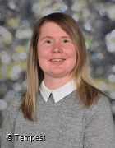



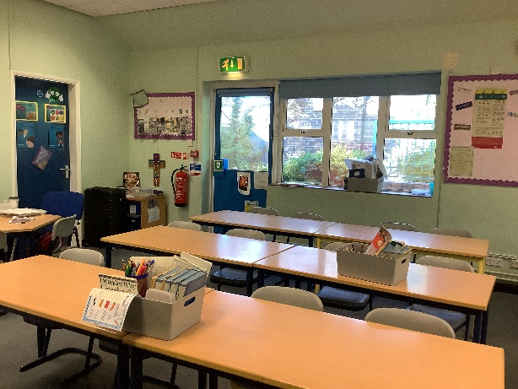


Hello and Welcome to 6S
Miss Mcnulty
Meet your new teacher and support staff.
We can’t wait to welcome you!
Mrs Wilson
Mrs Adams
Miss Hodgen
WELCOME TO 6S!
We’re looking forward to sharing our class texts of Holes, Skellig and Once with you this year. In Geography we’ll be learning lots about Rivers, Biomes and developing our Mapping Skills whilst in History, two of our topics are Ancient Greece and The Battle of Britain, so we will be going up to the Imperial War Museum North in Salford. In Science we’ll learn more about classification, how our bodies work and Electricity. Of course, we’ll be working towards our SATs in May.
There’s more, lots more! We can’t wait to get going!
Our new classroom;
Miss Mcnulty loves yoga, holidays, sunny weather and elephants!
In Year 6, we enjoy several trips including days at Stanley Head to enhance our Geography, local visits to the canal and Potteries Museum and the Uttoxeter Cinebowl
It’s certainly a busy final year and one that tends to fly!
Please reach out to me if you have any questions about your child.
“Education is one thing that no one can take away from you.”
For more information click here to see our year group page on our school website.

