Slide 1



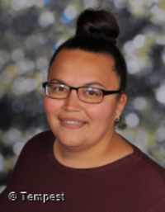
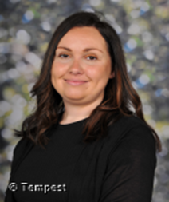
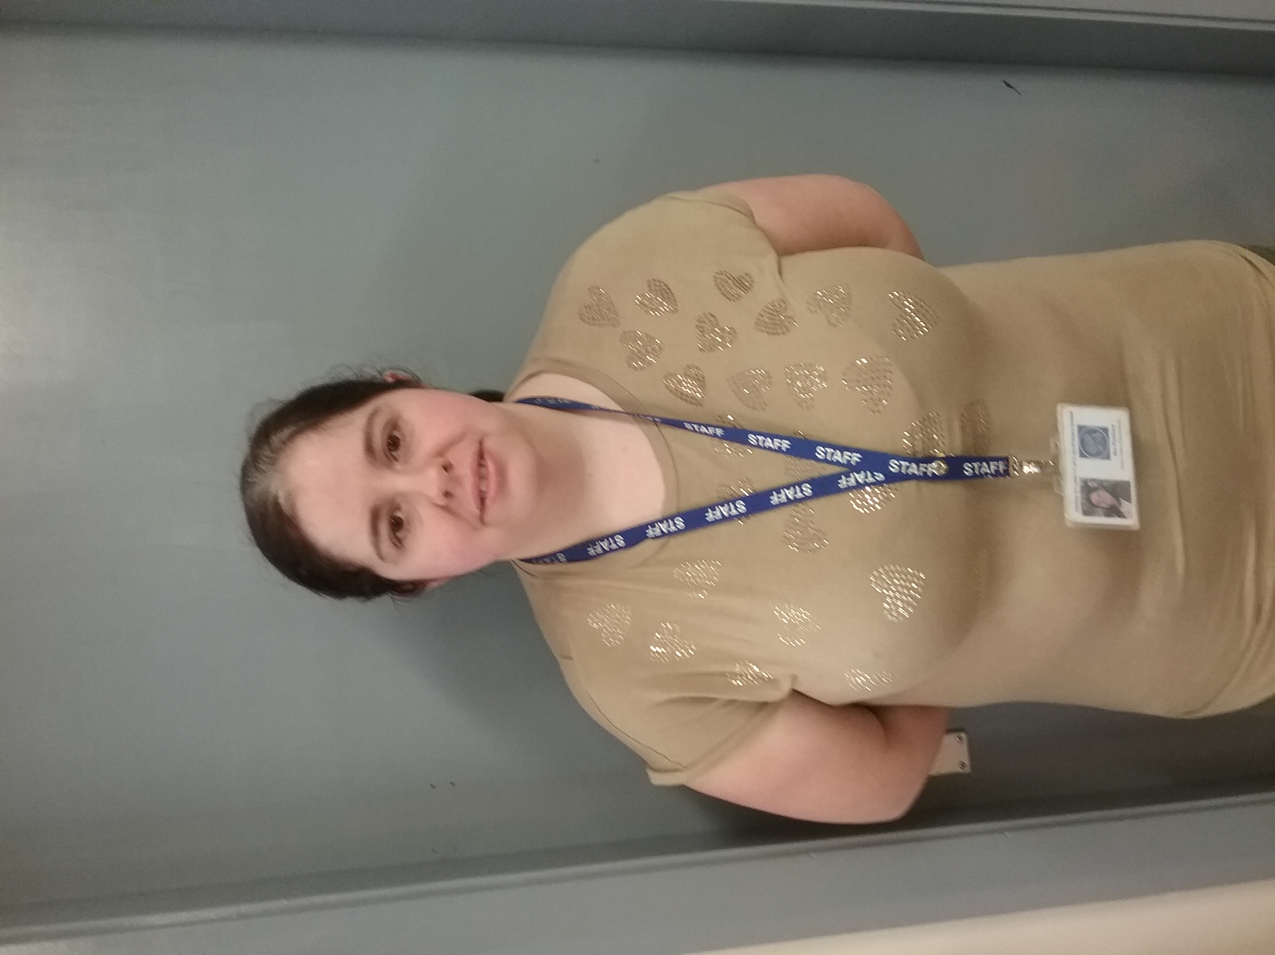


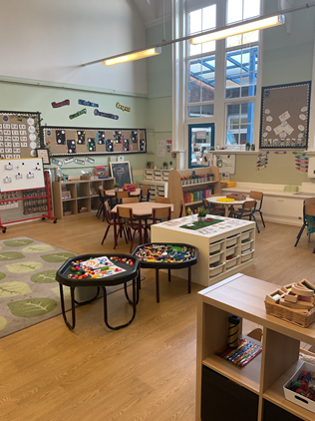


Hello and Welcome to R.S
Meet your new teacher and support staff.
We can’t wait to see you!
Miss Franklin
Mrs Rush
Mrs Pickford
WELCOME TO R.S!
We are proud to offer a warm, calm, and loving environment where your child will feel safe, happy, and supported from the very start. Our setting is fully free-flow, meaning children can choose how and where they learn—whether that’s indoors, outdoors, or in either of our connected classrooms. Each day is a balance of carefully planned adult-led activities and opportunities for children to follow their own interests, encouraging independence, creativity, and a love of learning. We absolutely love our Reception year and can’t wait to welcome your wonderful children into our nurturing and exciting community this September.
Our new classroom
Hi, I'm Miss Franklin, your child's class teacher. I’ve been teaching in Reception for just over a year now and absolutely love it! I’m a passionate and enthusiastic teacher who puts your child at the heart of everything I do. I believe in creating a warm, caring, and nurturing environment where every child feels valued and supported. At the same time, I ensure that clear and consistent boundaries are set to help children feel safe, respected, and ready to learn. I have two wonderful children of my own—an 11-year-old and a lively 2-year-old—so I completely understand how special and important these early years are. My favourite colour is blue, and I absolutely love the stories written by Julia Donaldson. Stick Man is my all-time favourite story, especially because it features one of my favourite people—Santa! I’m really looking forward to getting to know your little ones and helping them grow this year. Together, we’re going to have a fantastic time!
“Education is one thing no one can take away from you.”
Please reach out to me if you have any questions.
For more information, please visit our year group page on the school website

