Slide 1


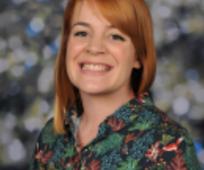
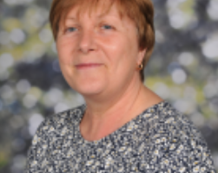

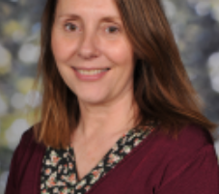


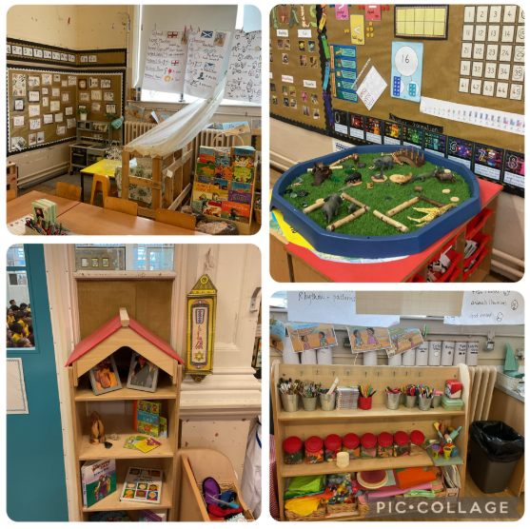



Welcome to 1S
Meet your new teacher and support staff.
We can’t wait to see you!
Mrs Furey
Mrs Higham
Mrs Whalley
WELCOME TO 1S!
Mrs Morris
We are so excited to welcome you and your child to Year 1. It’s going to be a fantastic year filled with fun, learning, and new adventures. In 1S, we dive into exciting topics like Toys from the Past, where we’ll take a trip to Brampton Toy Museum to see how toys have changed over time. We’ll explore Seasonal Changes with a nature walk to our local park, and learn all about the United Kingdom through creative activities – including building our very own leprechaun traps! Later in the year, we’ll discover the world of Animals and different animal groups, with a special visit to the zoo. We can’t wait to get started and look forward to a brilliant year ahead with your children!
Our new classroom;
Your teacher will be Mrs Furey on Monday, Tuesday, Wednesday, and Friday, and Mrs Whalley will be your teacher on Thursdays. You’ll also see Mrs Higham and Mrs Morris in class every day—they’ll be helping us with our learning and making sure we have a fantastic time at school.
We can’t wait to meet you all in September and begin our journey together. Year 1 is a very special time, and we’re so excited to share it with you!
Please reach out to me if you have any questions about your child.
“Education is one thing that no one can take away from you.”
For more information click here to see our year group page on our school website.

