Slide 1


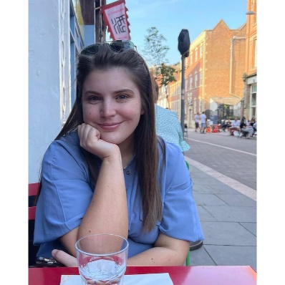
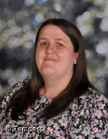



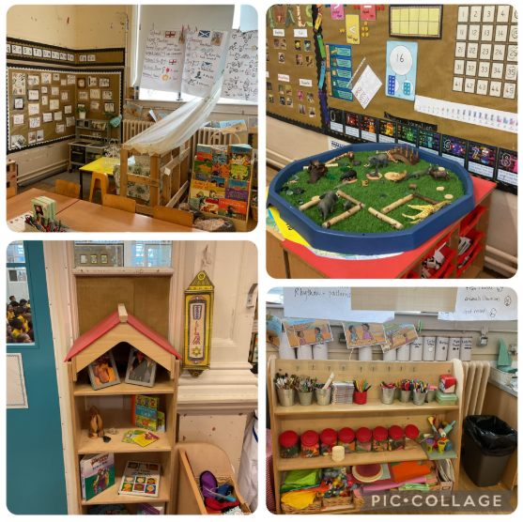


Hello and Welcome to 1L!
Meet your new teacher and support staff.
We can’t wait to see you!
Miss Jones
Mrs Fern
WELCOME to 1L!
Welcome to Year 1! We can’t wait to meet you all. We love to learn and have fun along the way. We have lots of exciting things planned this year and we look forward to meeting you all! We are going on lots of exciting trips and walks to local places to enhance our learning.
We have fun and interesting topics to study including the United kingdom, Fairy tales and animals.
We can’t wait for September and to begin our new learning with you all.
See you soon!
Our new classroom;
  As I am new to the school, I can’t wait to learn all about Hanley St Luke’s with you as we move into Year One!
  Year One is the best year at school after all!
  We have so many exciting things planned. I think we are going to have the best year ever!
Please reach out to me if you have any questions about your child.
“Education is one thing that no one can take away from you.”
For more information click here to see our year group page on our school website.

