Slide 1


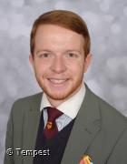
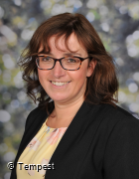



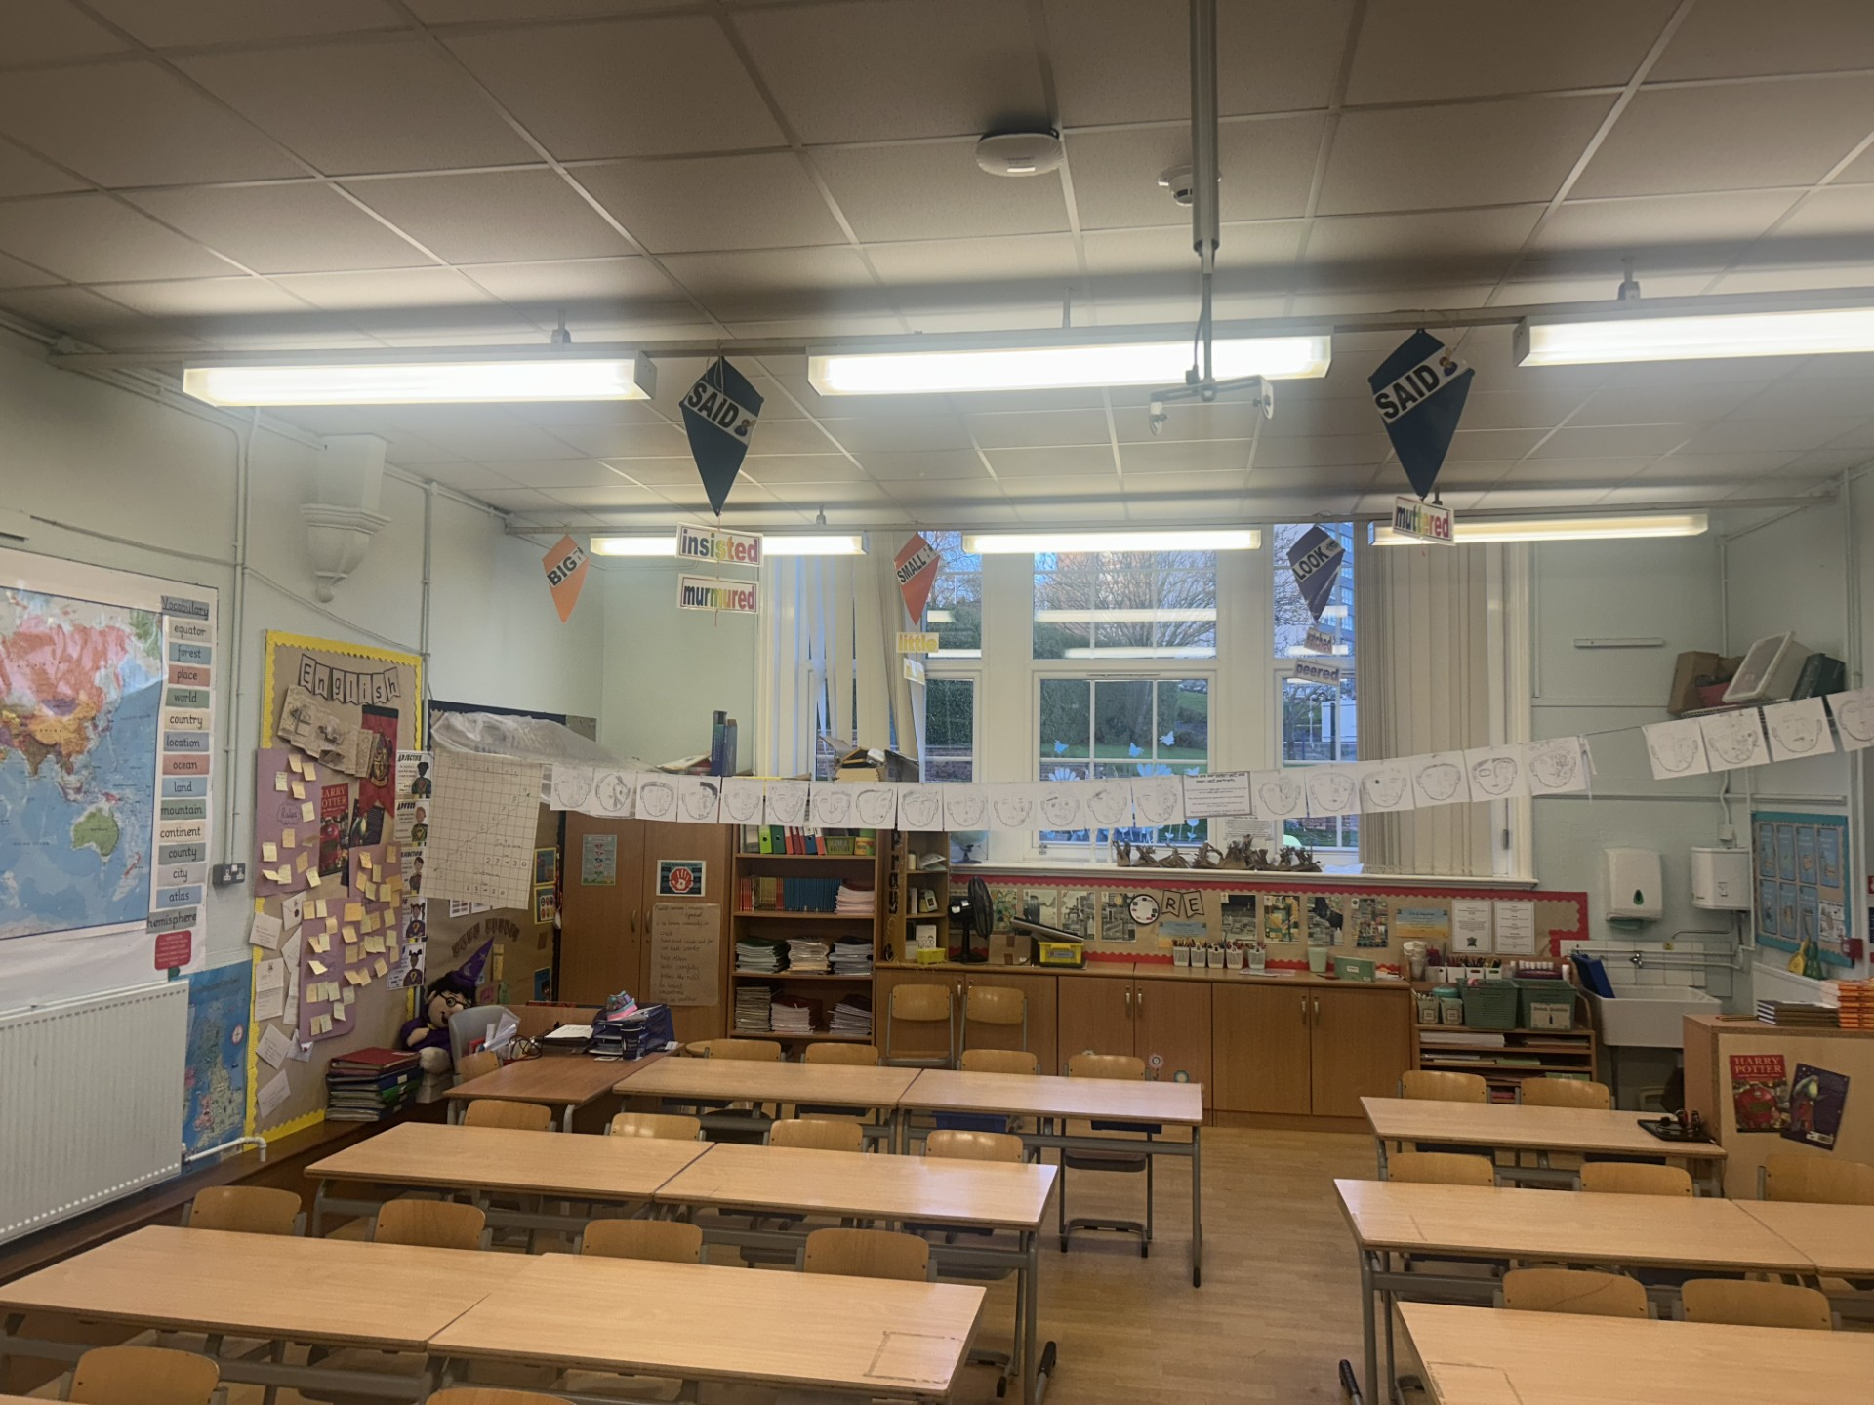


Hello and Welcome to 4S
Meet your new teacher and support staff.
We can’t wait to see you!
Mr Whiston
Mrs Cotton
WELCOME TO 4S!
In Year 4, we’re looking forward to going on a variety of trips and local walks to enrich our learning Some of the places we plan to visit include Hanley Library and Stanley Head. WE have many exciting topics to explore this year, including Sound, Electricity, Volcanoes, Mountains and Earthquakes, as well as The Vikings and Egyptians.
On PE days, children should come to school dressed in their PE kits.
PE takes place ever Monday (indoors) and Thursday (outdoors)
Our new classroom;
  We can’t wait to meet you all in September and begin our journey together. Year 4 is a wonderful time full of new learning, friendships, and adventures — and we’re so excited to be part of it with you.
  Here’s a little bit about us…
  Mr Whiston loves Science and English. He is also a huge Newcastle United Fan and loves to watch both football and cricket. Outside of school Mr Whiston enjoys long country walks, swimming and going on holiday to many different destinations. and discovering new places on holiday.
  Mrs Cotton loves music and English. She has 2 grown up children and loves to watch musicals at the theatre.
  We’re both really looking forward to getting to know all of the children. We hope for an exciting, happy and successful year, full of memories.
“Education is one thing that no one can take away from you.”
Please reach out to me if you have any questions about your child.
For more information click here to see our year group page on our school website.

