Slide 1


Slide 2
Transforming Children & Young People’s Mental Health: A Green Paper (2017)
Mental Health Support Teams
Senior Mental Health Lead
creating a new mental health workforce of community-based mental health support teams
every school and college will be encouraged to appoint a designated lead for mental health

Slide 3
Mental Health Support Team (MHST) – 3 Core Functions
Evidence-based support
Support the Senior Mental Health Lead to develop the Whole School/College Approach to mental health & Wellbeing
Give timely advice and guidance to staff, liaise with external specialist services to help CYP get the right support and stay in education
Advice & signposting
Whole school/college approach
To deliver evidence-based interventions for mild-moderate mental health issues
Notes:
Primary age cyps – parent-led interventions
Work with SMHL, plan groups, workshops, assemblies, events – attend special events = for pupils, staff & parents
Targeting early intervention work

Slide 4
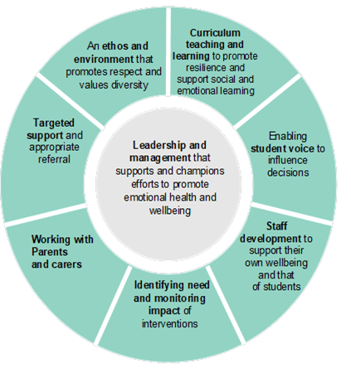
Whole School Approach – 8 Principles (PHE et al 2021)
Notes:
Taking a Whole School Approach involves looking through a new lens, considering the effect of every aspect of school or college life on mental health and wellbeing
Evidence gathering exercise – strengths & targets – action plan – how MHST can collaborate to work on target areas and maintaining strengths
Voice Capture – Staff, parent/caregivers and pupils may be asked to be a part of this - they are usually anonymous and are used to support the school in looking at ways to improve the mental health and wellbeing.

Slide 5
MHST groups/workshops for pupils
Worry/anxiety management
Introduction to sleep hygiene
Introduction to mental health awareness
Healthy relationships (KS2)
Understanding resilience (KS2)
Body image (KS2)
Peer mentoring/Wellbeing Ambassadors
5 ways to wellbeing
Bouncebackability (Resilience)
Notes:
Have support workers in the team who can support in delivering these
Chosen based on MHL consultations and voice capture

Slide 6

Parent/carer workshops/coffee morning themes
Anxiety
Behavioural difficulties
Sleep hygiene
Understanding and supporting my child’s emotions
Understanding and talking to children about suicide and self-harm
Notes:
Decisions on which groups run and when is up to the school and the MHL
Suicide and self-harm for parents not typically delivered to CYP in primary unless school think would be beneficial, conversation had with caregiver first

Slide 7
Evidenced based support
Education Mental Health Practitioners (EMHP)
complete a postgraduate diploma qualification to deliver guided self-help principles and LICBT interventions (low intensity cognitive behaviour therapy).
Trained to work with mild to moderate MH concerns focusing on early intervention and prevention.
EMHPs are now registered professionals either the BABCP/BPS (British Association for Behavioural and Cognitive Psychotherapies/ British Psychological Society).
Notes:
Deliver LI-CBT with CYPs and their caregivers on anxiety / worry and behavioural difficulties or signpost to another service.
Mild to moderate mental health needs refer to emotional or behavioural challenges that a child might face, which can impact their daily life.
Examples of mild to moderate mental health difficulties include anxiety, low mood, mild behavioural difficulties and stress-related problems.

Slide 8
What does parent-led mean?
For children 12 and under, it’s recommended that the
work is completed with parents/carers – rather than the
child (NICE guidelines).
Parents/carers play a crucial role in their child’s development, being actively involved in the intervention means they can better understand their child's needs.
Empowering the parent/carer and giving them support whilst doing so is very effective in supporting the MH and wellbeing of their child(ren).

Slide 9
What the MHST is not
A replacement for when a child needs long
term support or counselling.
Able to support with bereavement.
Able to support trauma.
A short cut to core CAMHS services.
A diagnostic service for ASD/ADHD.
Able to support children with complex or impactful environmental/social issues.
A crisis service.

Slide 10
MHST referrals
Referrals are received through a consultation process with schools with the MH lead. A specific child/young person, who is not currently open to our service is discussed resulting in the provision of advice, guidance, resources or signposting to other agencies/services depending on the needs of the CYP.
The consultations are generic discussions to present a child/young person (CYP) using non-identifiable data.
Notes:
Through parents/carers - When qualified

Slide 11

Thank you for listening
Any questions?

