Slide 1


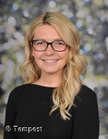
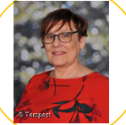





Hello and Welcome to 5S
Meet your new teacher and support staff.
We can’t wait to welcome you!
Miss Hirst
Mrs Emery
WELCOME TO 5S!
We can’t wait to explore our new topics together. In Year 5, our class texts will be..... . In History, we will dive into our local history, looking at what ‘The Potteries’ is known for and how the industrial revolution influenced the pottery industry and the future of our city! We will also study ancient Islamic civilizations and answer questions such as: What was the Golden Age of Ancient Islamic Civilizations? In Geography, we will take a closer look at North and South America and compare certain regions to the West Midlands. It’s going to be a jam-packed year filled with lots of learning!
Our new classroom;
In Year 5, we will enjoy trips to Stanley Head, the Wolseley River Centre, Gladstone Pottery Museum and Hanley Library, as well as enjoying live workshops, visitors and much more in school!
Miss Hirst and Mrs Emery love being outdoors and spending time with their families. We both loves to visiting countries and cities far and wide especially those with fascinating architecture, beautiful landscapes and local cuisine.
We can’t wait to find out about you!
Please reach out to me if you have any questions about your child.
“Education is one thing that no one can take away from you.”
For more information click here to see our year group page on our school website.

