Slide 1



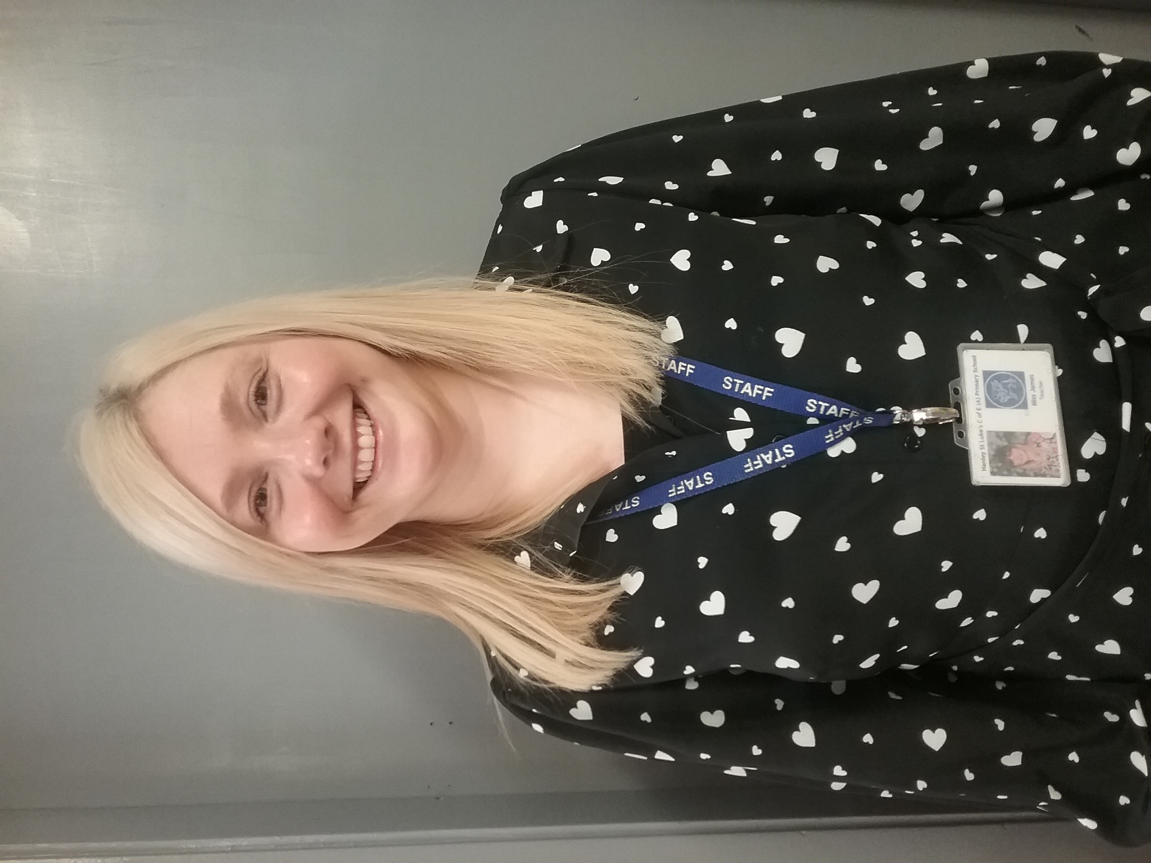
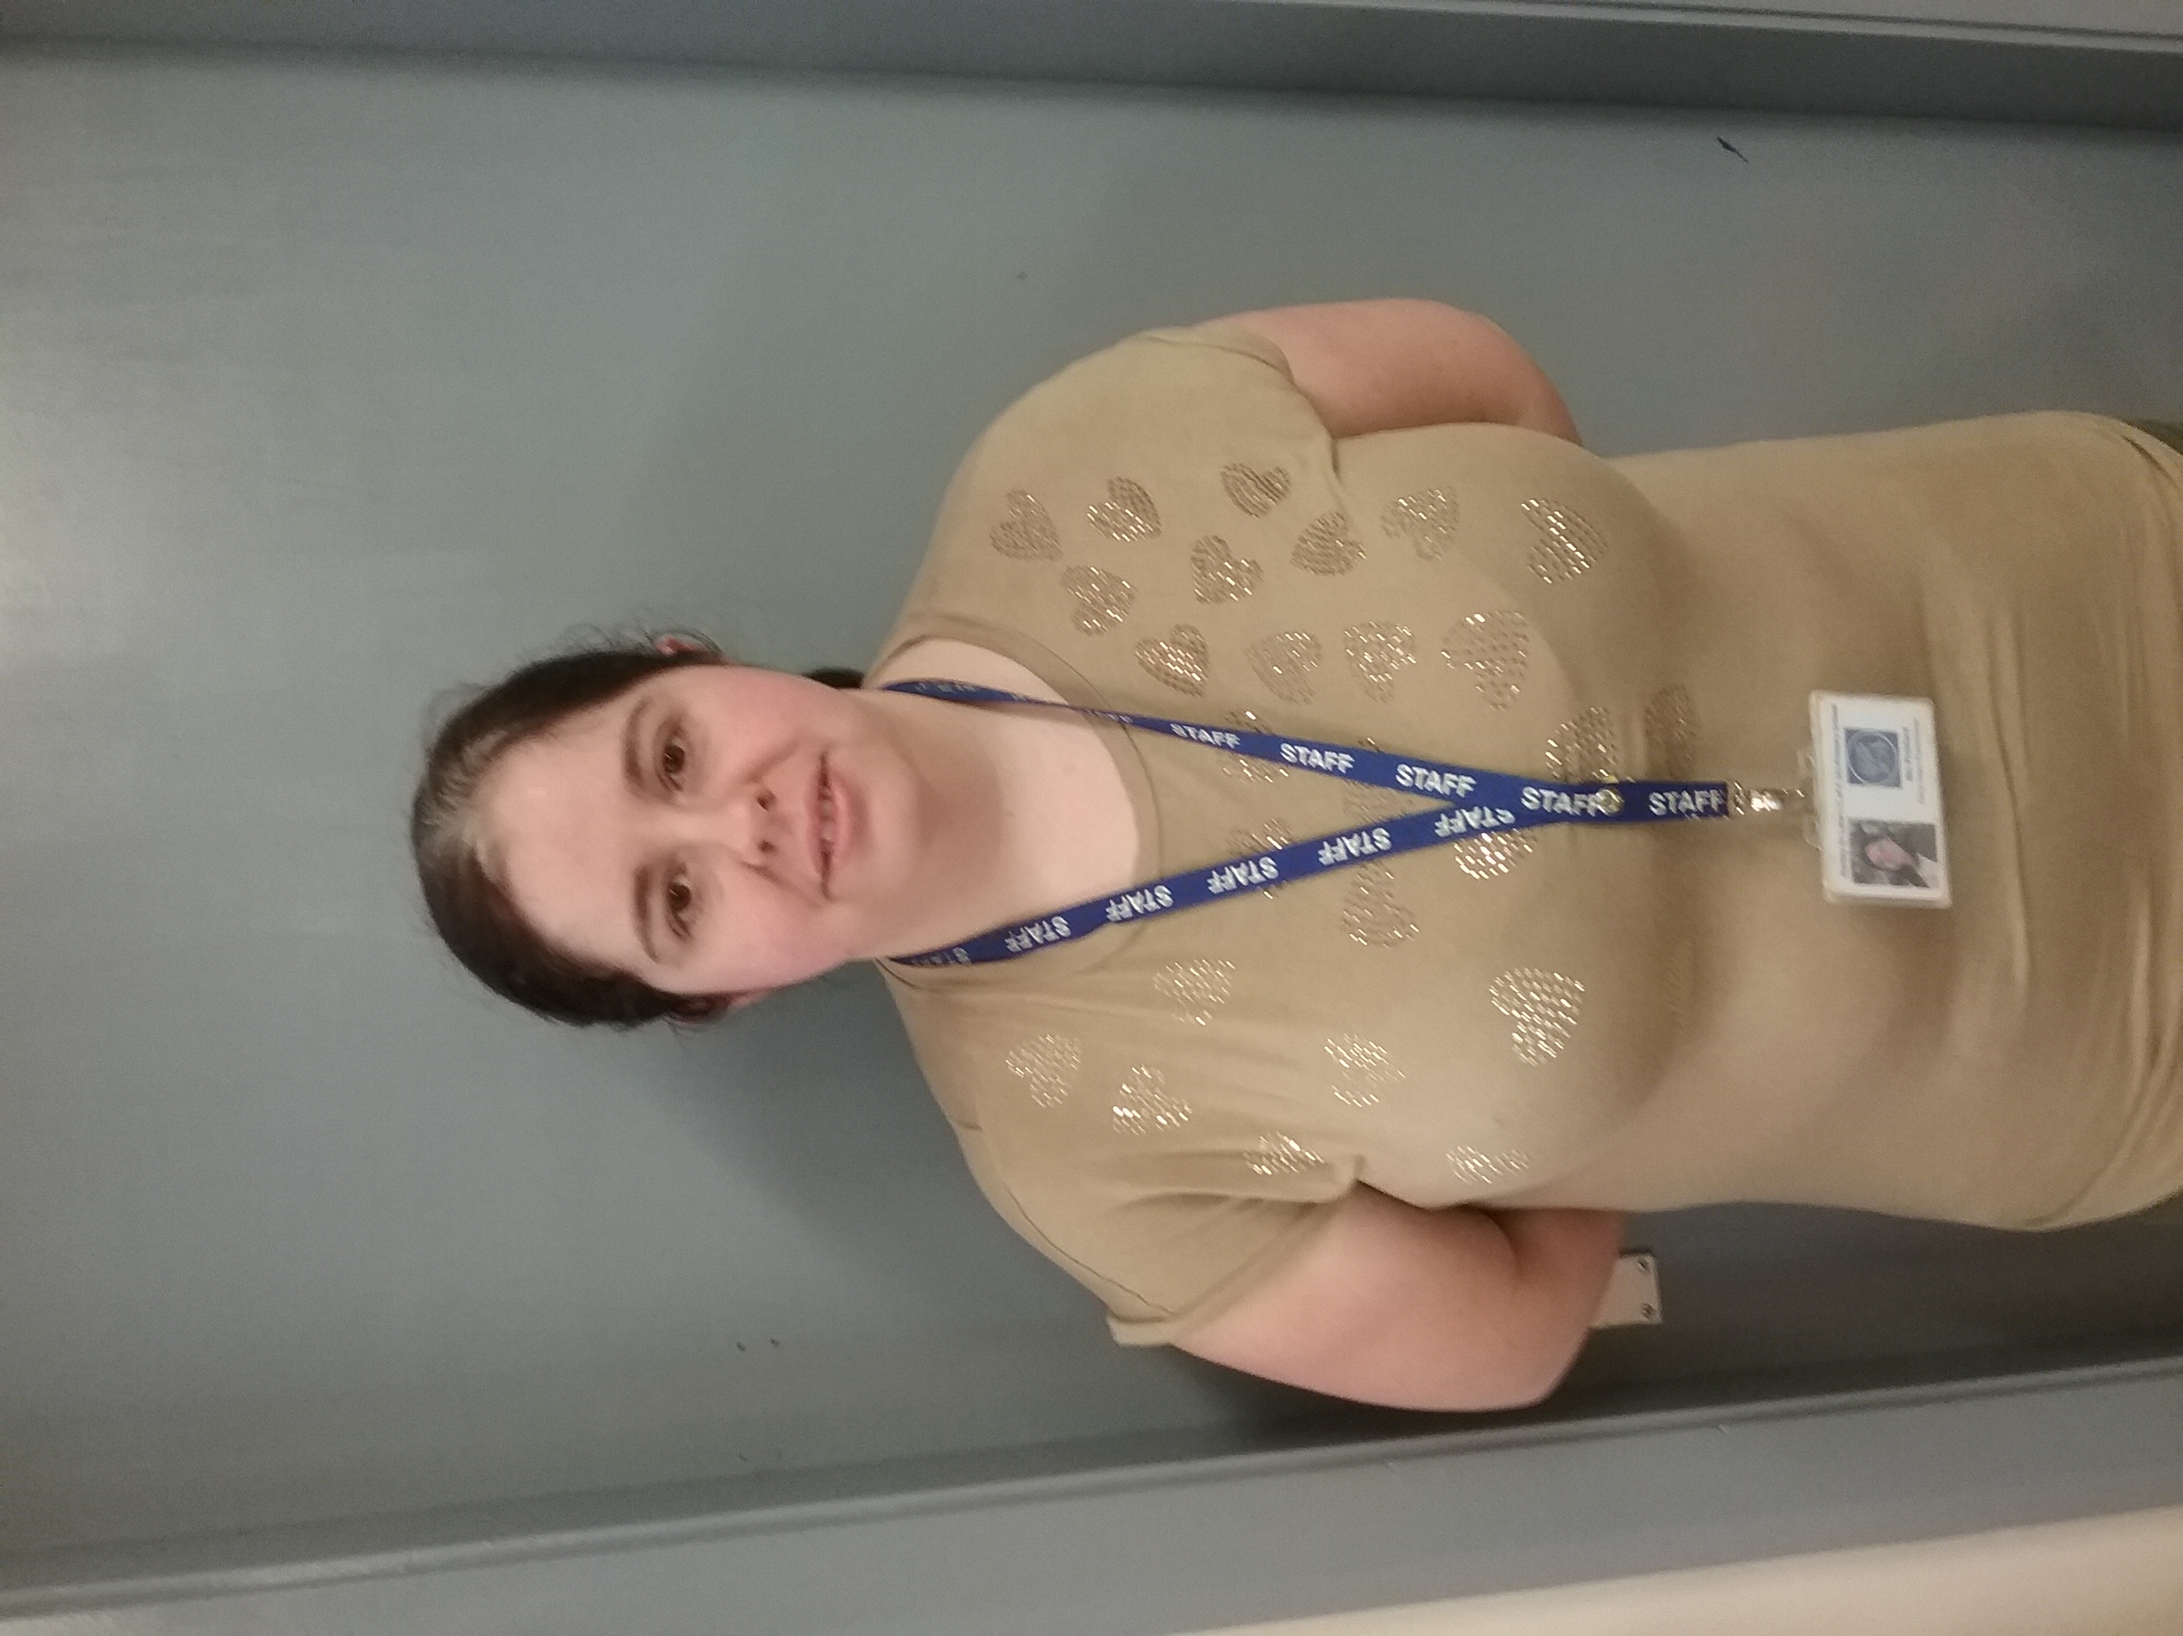
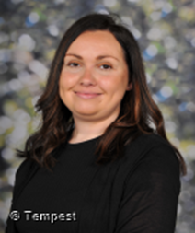
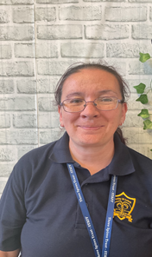


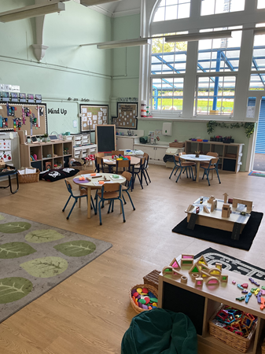
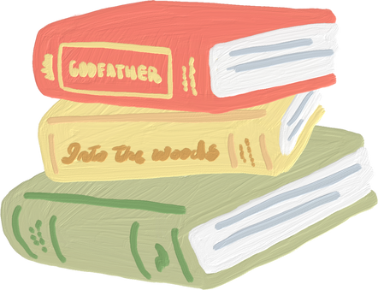

Hello and Welcome to R.L
Meet your new teacher and support staff.
We can’t wait to see you!
Mrs Clay
Mrs Pickford
Mrs Rush
Mrs Grundy
WELCOME TO R.L!
We are proud to offer a warm, calm, and loving environment where your child will feel safe, happy, and supported from the very start. Our setting is fully free-flow, meaning children can choose how and where they learn—whether that’s indoors, outdoors, or in either of our connected classrooms. Each day is a balance of carefully planned adult-led activities and opportunities for children to follow their own interests, encouraging independence, creativity, and a love of learning. We absolutely love our Reception year and can’t wait to welcome your wonderful children into our nurturing and exciting community this September.
Our new classroom
Hello! My name is Mrs. Clay, and I am the teacher in R.L. I have been an EYFS teacher at the school for over seven years, and I absolutely love working with young children. I’m a happy, smiley, and bubbly person who loves to laugh, sing, and dance, and I’m excited to share lots of fun and learning with you all. My favourite colour is blue, and one of my favourite stories to read is The Gruffalo. Outside of school, I have two wonderful children who bring me lots of joy. I can’t wait to get to know everyone and make this year a fantastic one!
“Education is one thing no one can take away from you.”
Please reach out to me if you have any questions.
For more information, please visit our year group page on the school website

