Slide 1


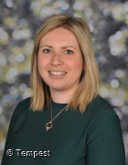
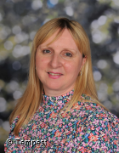



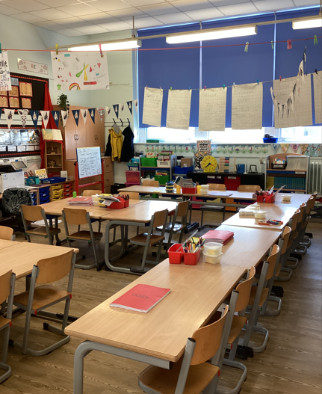


Hello and Welcome to 3S
Meet your new teacher and support staff.
We can’t wait to see you!
Mrs Cordon
Mrs Thomspon
WELCOME TO 3S!
In Year 3, we’re looking forward to going on a variety of trips and local walks to enrich our learning. Some of the places we plan to visit include Conkers , Hanley Library, and Chester.
We have many exciting topics to explore this year, including the Stone Age, Bronze Age, and Iron Age, as well as the Rainforest and the Romans.
On PE days, children should come to school dressed in their PE kits. PE takes place every Monday (indoors) and Tuesday (outdoors)
Our new classroom;
  We can’t wait to meet you all in September and begin our journey together. Year 3 is a wonderful time full of new learning, friendships, and adventures — and we’re so excited to be part of it with you.
  Here’s a little bit about us…
  Mrs Cordon is a busy mum to two young children and has a lovely dog named Otis. She enjoys spending her weekends going on long walks with her family and exploring the great outdoors. Mrs Thompson has two grown-up children and loves spending quality time with her family. She also enjoys travelling and discovering new places on holiday.
  We’re both really looking forward to getting to know each and every one of you and making this year a happy, successful, and memorable one.
Please reach out to me if you have any questions about your child.
“Education is one thing that no one can take away from you.”
For more information click here to see our year group page on our school website.

